Slide 1

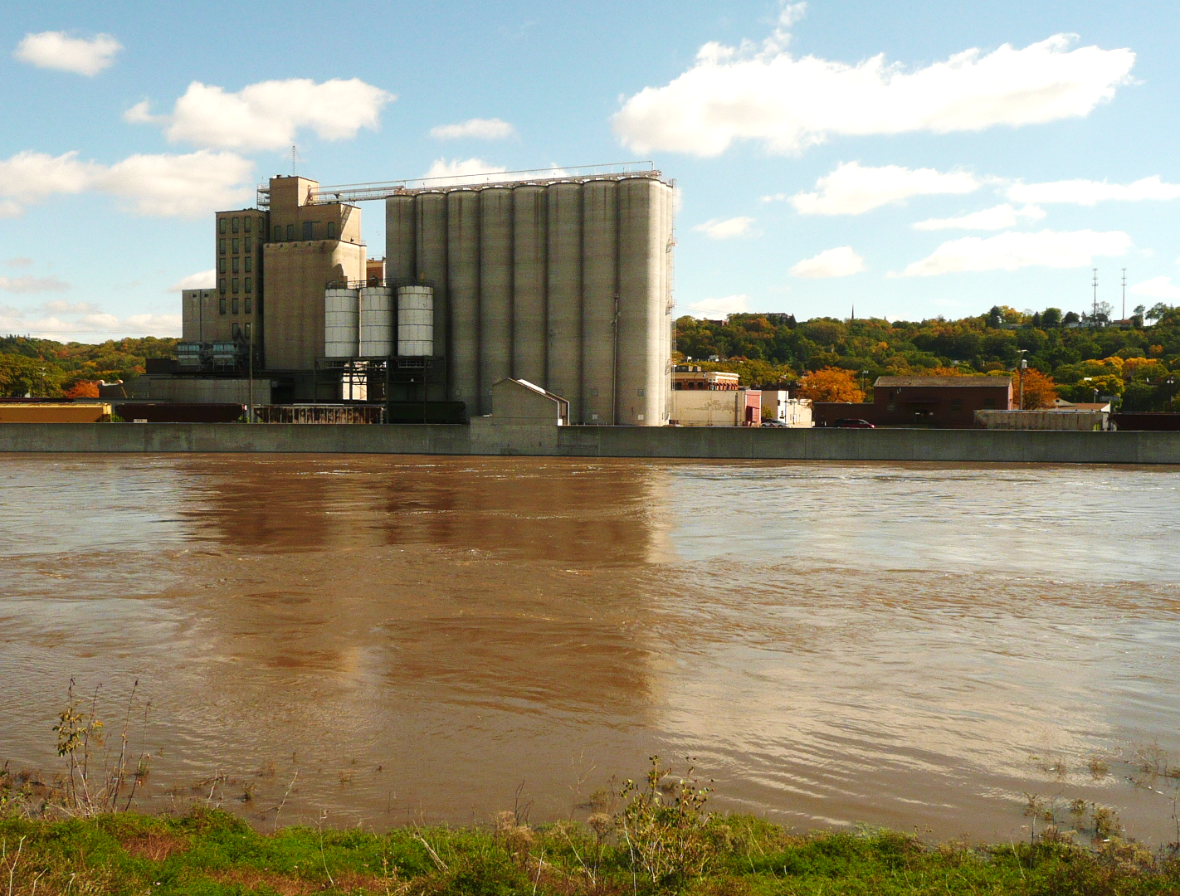
Importance of Long-Term Data: Mankato Sediment Record
Jeffrey Ziegeweid: USGS Upper Midwest Water Science Center
Presented to: LCC Subcommission on Minnesota Water Policy
August 20, 2019
U.S. Department of the Interior
U.S. Geological Survey

Slide 2
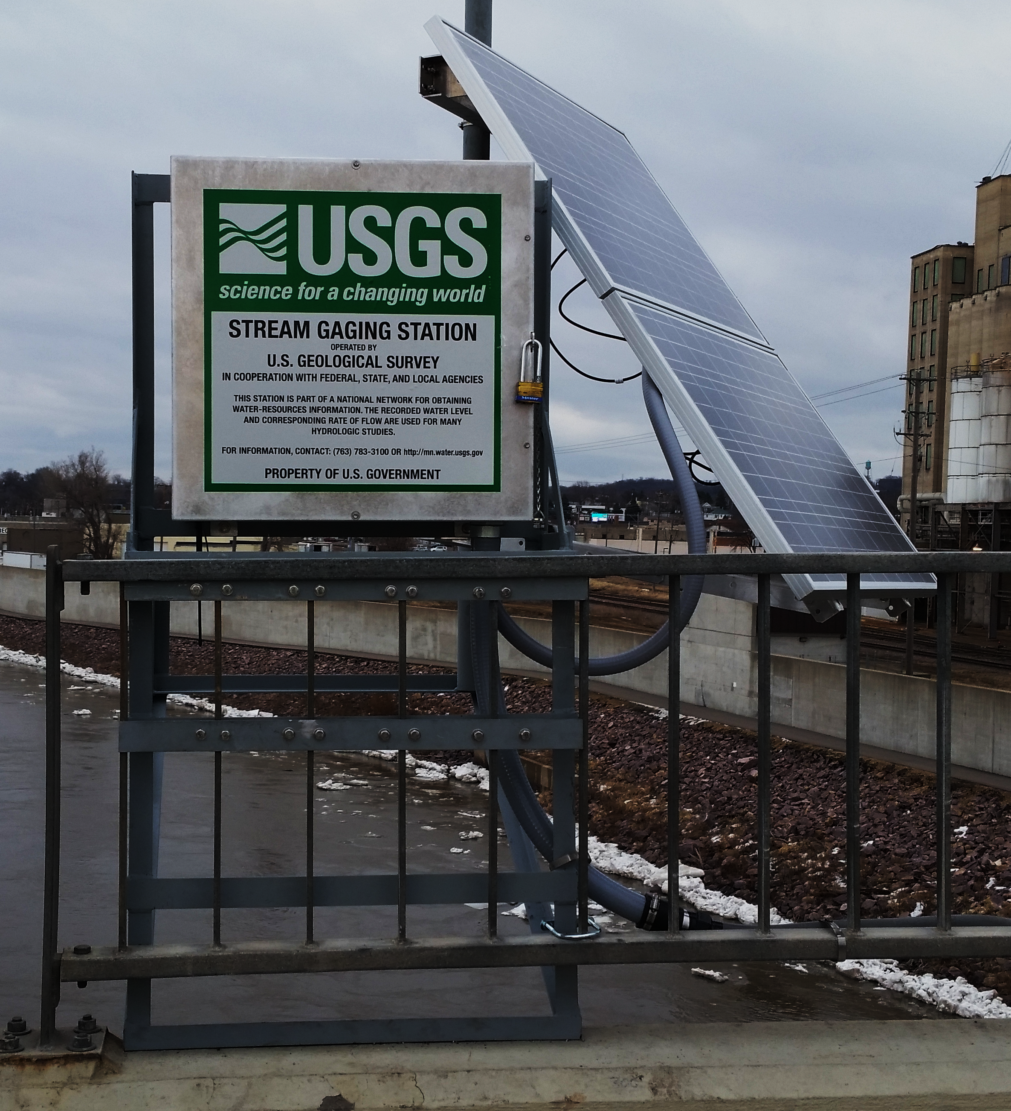

Examples of Long-Term Data
Continuous streamgages:
Streamflow (many)
Water-Quality (few) - $$$, difficult
Temperature
Suspended Sediment
Chloride

Slide 3
Applications of Long-Term Data
Estimate flows: ungaged sites¹
State: WLA², Withdrawals³
Tools to understand processes⁴
Identify trends: indicate disturbance
Causes, multiple scales^{5,6,7,8}
Harmonize method changes^{10,11,12}

Slide 4
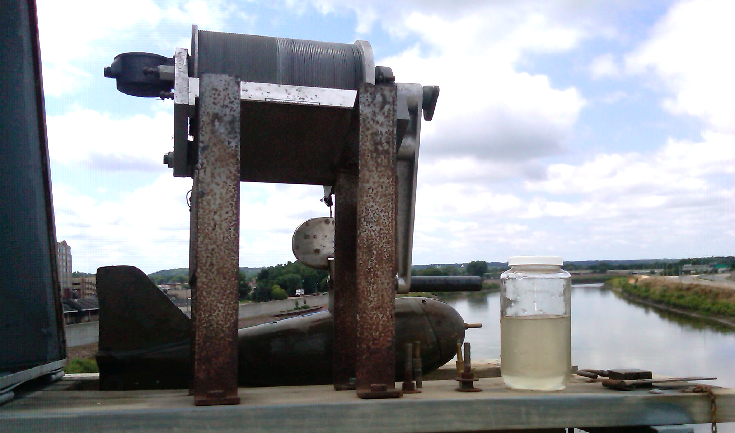
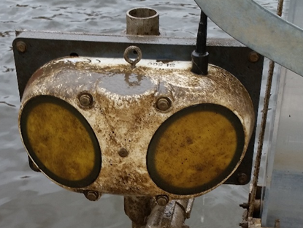
05325000: Minnesota River at Mankato, MN
Flow - 1904, suspended sediment - 1968
Longest MN sediment record
Observer: 1968-2017
Acoustic sensor: 2013-2019
Used by researchers and resource managers⁴⁻¹³
Study environmental change

Slide 5
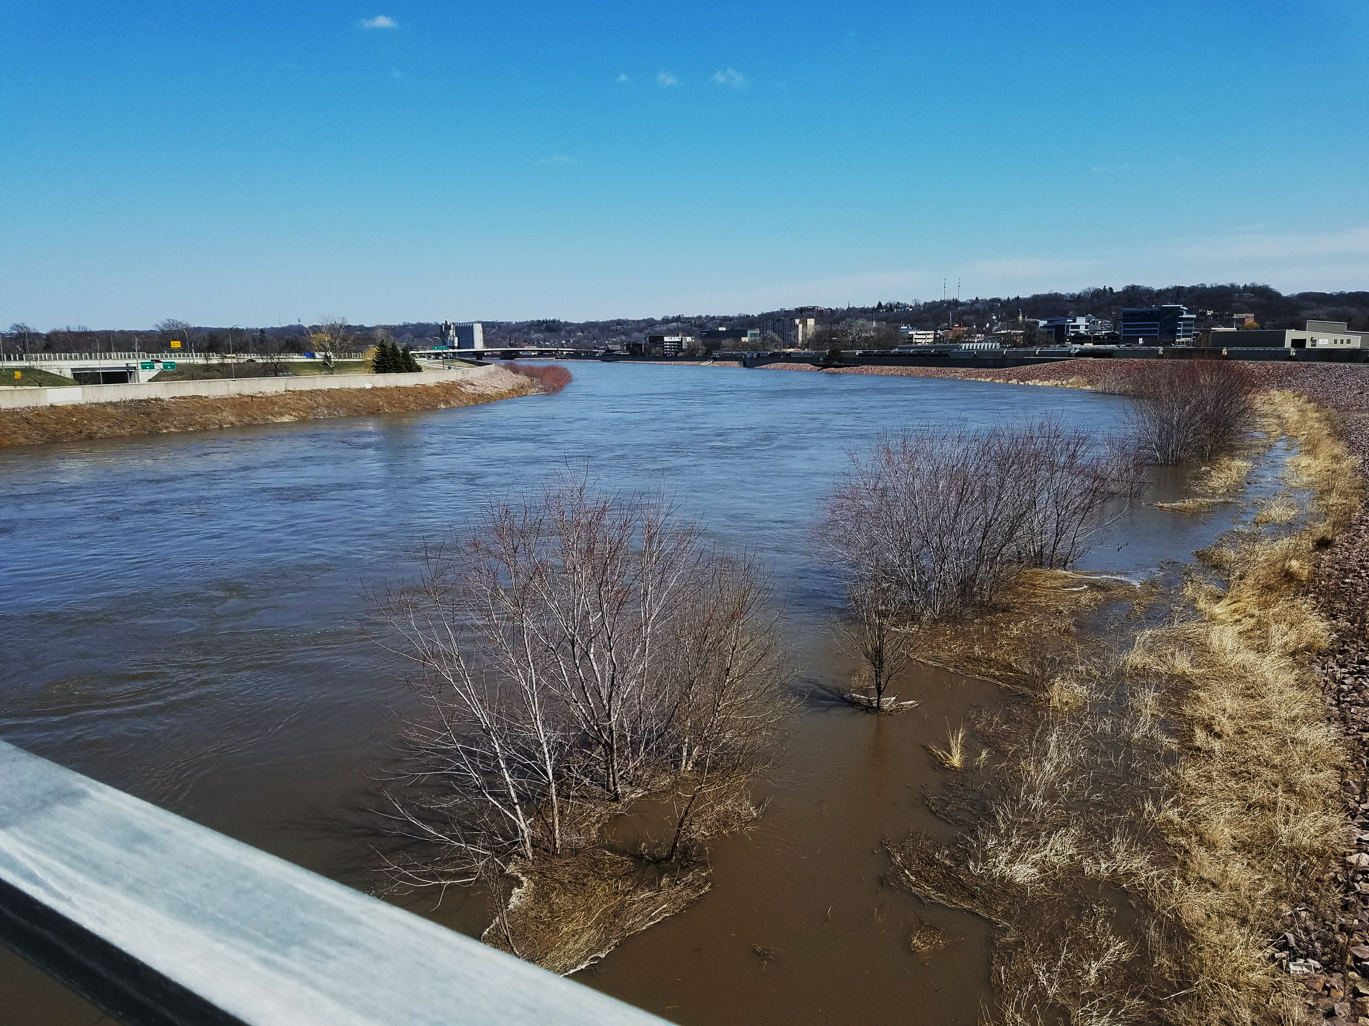
Some Key Findings (Non-USGS)
Flows increasing^{6,7,8,9}
Land cover, precipitation
Most sediment from river banks and bed⁷
Depth same, width increase
MPCA developed sediment TMDL using TSS and flow^{13,14}
90% reduction to meet goal

Slide 6


More to the Story: Recent USGS Studies (1)
SSC vs flow¹²
Highly variable

Slide 7
More to the Story: Recent USGS Studies (2)
TSS misses ~ 50% of supended sediment load:^{10,11,15}
Suspended sand, bedload

Slide 8
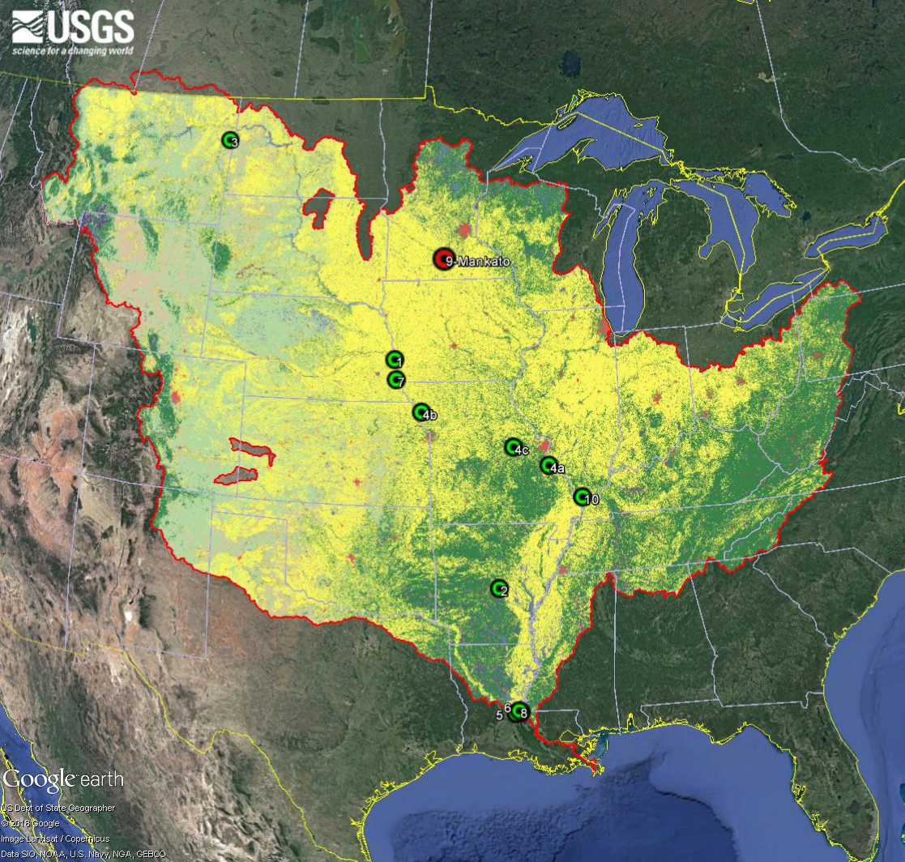
Mankato Sediment Record in Jeopardy
After 2019, no funding for sediment data
9th longest daily record in Mississippi Basin⁵
Affects many study scales
Local, state, national

Slide 9
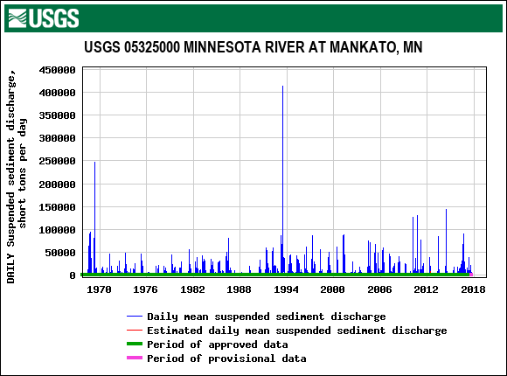
Take Home Messages
Long-term data: many uses
Longest sediment record in MN at risk
Current TMDL methods underestimate loads^{11,13,15}
Still work to be done

Slide 10




References and Partner Acknowledgments
Ries, K.G. and others, 2004, USGS Fact Sheet FS-2004-3115, 4 p.
Carol Sinden, MPCA, written communication, 2016.
Brent Mason, MNDNR, written communication, 2019.
TetraTech, 2015, Memorandum: Minnesota River Basin HSPF Model Hydrology Calibration.
Heimann, D.C. and others, 2011, U.S. Geological Survey Scientific Investigations Report 2011–5200, 33 p.
Lenhart, C.F. and others, 2011, Watershed Science Bulletin (April 2011): 25-31.
Lenhart, C.F. and others, 2013, Transactions of the ASABE 56(2): 549-561.
Schottler, S.P. and others, 2014, Hydrological Processes 28: 1951-1961.
Kelly, S.A. and others, 2016, Hydrol. Earth Syst. Discuss., doi:10.5194/hess-2016-571
Groten, J.T. and others, 2016, U.S. Geological Survey Scientific Investigations Report 2016–5174, 29 p.
Groten, J.T., and Johnson, G.D., 2018, U.S. Geological Survey Scientific Investigations Report 2018–5023, 23 p.
Groten, J.T. and others, 2019, U.S. Geological Survey Scientific Investigations Report 2018–5165, 30 p.
MPCA, 2019, Lower Minnesota River.
MPCA, 2019, Sediment Reduction Strategy: Minnesota River Basin and South Metro Mississippi River.
Ellison, C.A. and others, 2014, U.S. Geological Survey Scientific Investigations Report 2013-5205, 56 p.

