Slide 1
Perfluoroalkylated substances (PFAS)
B. Abylkhani and
Jim Park
University of Wisconsin-Madison

Slide 2
Outline
PFAS substances identity
PFAS substances chemical/physical properties
PFAS uses
PFAS regulations: water & soil
PFAS removal in liquid - literature review
PFAS removal in liquid with Resins – literature review

Slide 3
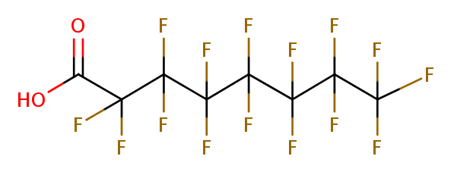
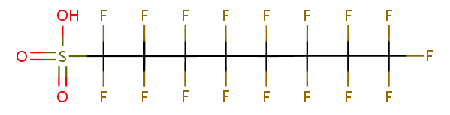
PFAS Substances Identity
Perfluoroalkylated (PFAS) substances consist of a large group of substances a fully fluorinated hydrophobic alkyl chain of varying length (4-16 C atoms) and a hydrophilic end [R, F(CF₂)_{n}R]
Within PFAS groups, two major substances are reported and studied: Perfluorooctanoic acid (PFOA) and Perfluorooctane sulfonic acid (PFOS):
  PFOA - C₈HF₁₅O₂
  PFOS - C₈F₁₇SO₃₋
PFAS have high compound stability.
PFAS are bioaccumilative, persistent and toxic.
PFOA
PFOS

Slide 4
PFAS Chemical/Physical Properties
Property | PFOA | PFOS
Appearance at 25°C and 1 atm | White powder/ waxy white solid | White powder
Mol. Weight | 414 g/mol | 538 g/mol
Water Solubility | 4.1 g/L at 22°C 9.5 g/L at 25°C | 0.52 g/L at 20°C 0.68 g/L at 24.5°C
Melting point | 45-50°C | >400°C
Boiling point | 189-192°C | not measurable
pKa | 2 to 3 | -3.3
log K_{oc} | 2.06 | 2.57
Half-life | 2.3 years | 4-9 years

Slide 5
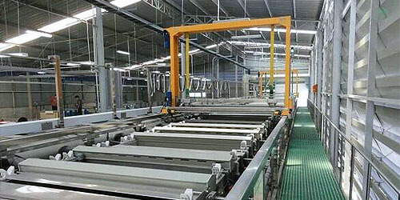

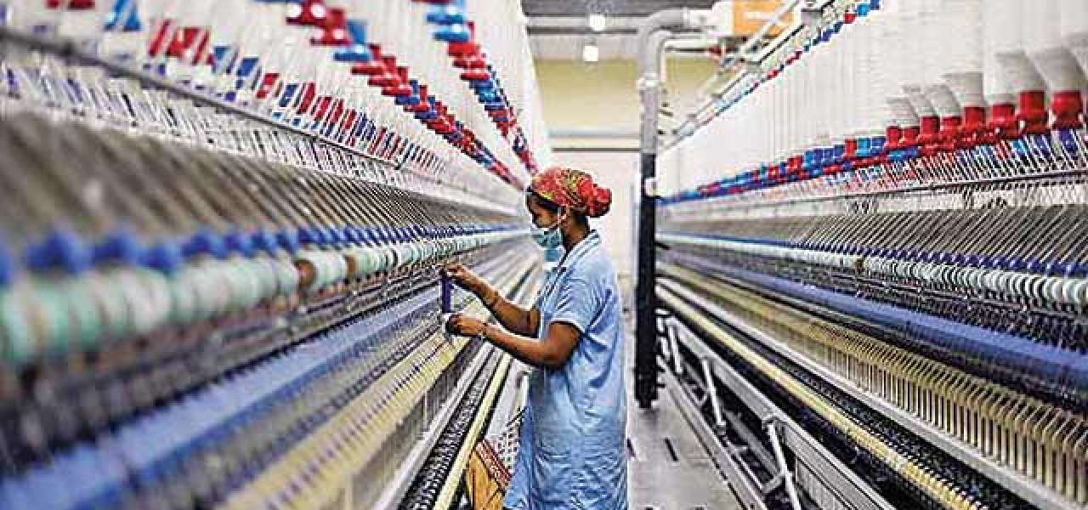
PFAS Uses (1)
Metal plating & etching – PFAS are used to reduce surface tension, prevent corrosion and reduce mechanical wear.
Personal care products - PFAS are used as emulsifiers, antistatics, stabilizers, film formers, viscosity regulators and solvents.
Textile & clothing – PFAS are used to make clothing water, oil and stain resistant.

Slide 6
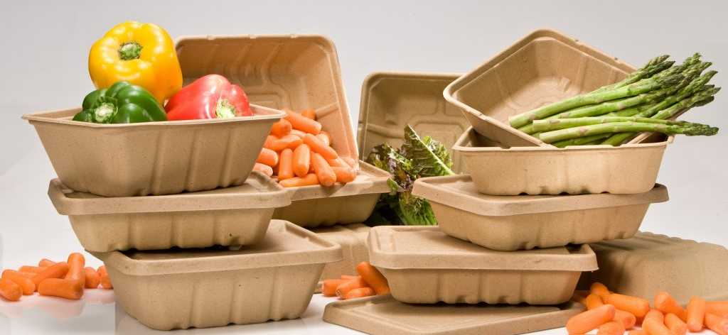

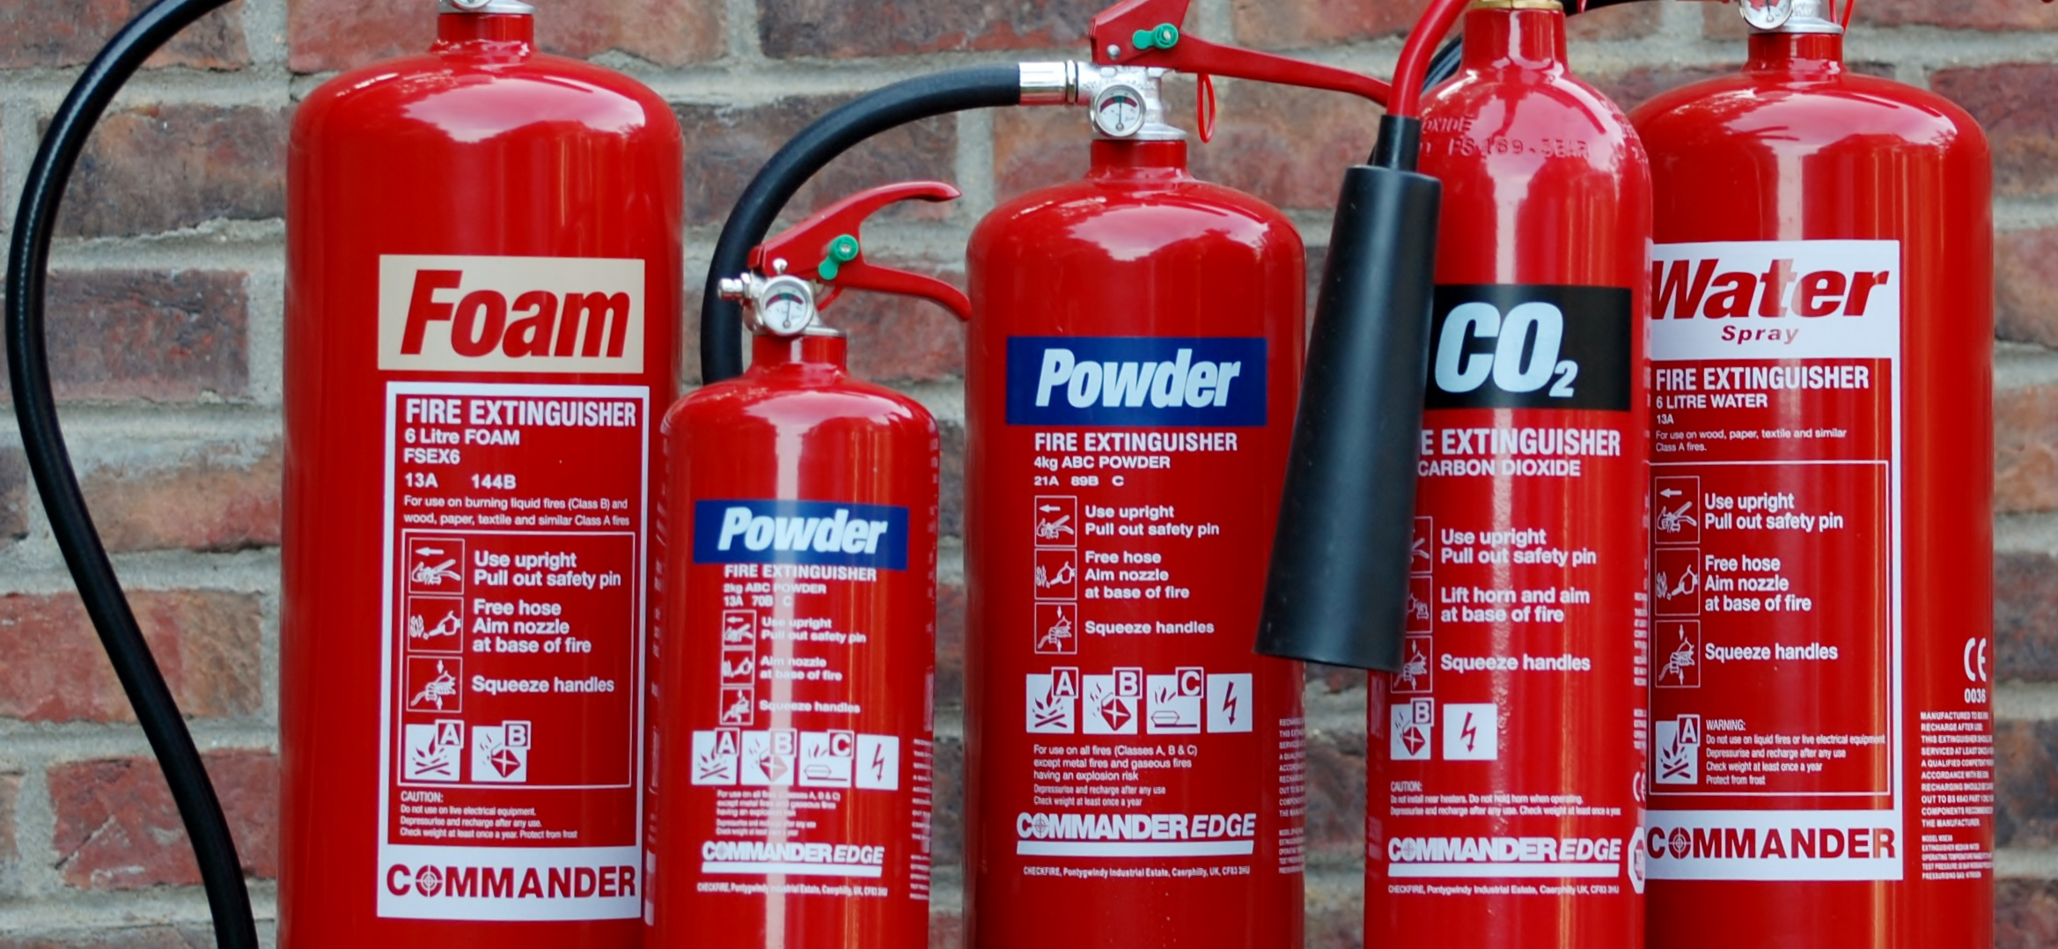
PFAS Uses (2)
Paper & food packaging – PFAS are used to manufacture grease, oil and water repellent products.
Household products - PFAS used as wetting, smoothing agents for paint; PFAS is used to make temperature resistant non-stick products.
Fire extinguishers class B (liquids) - PFAS are used to quickly spread foam over liquids, to inhibit evaporation and heat radiation.

Slide 7


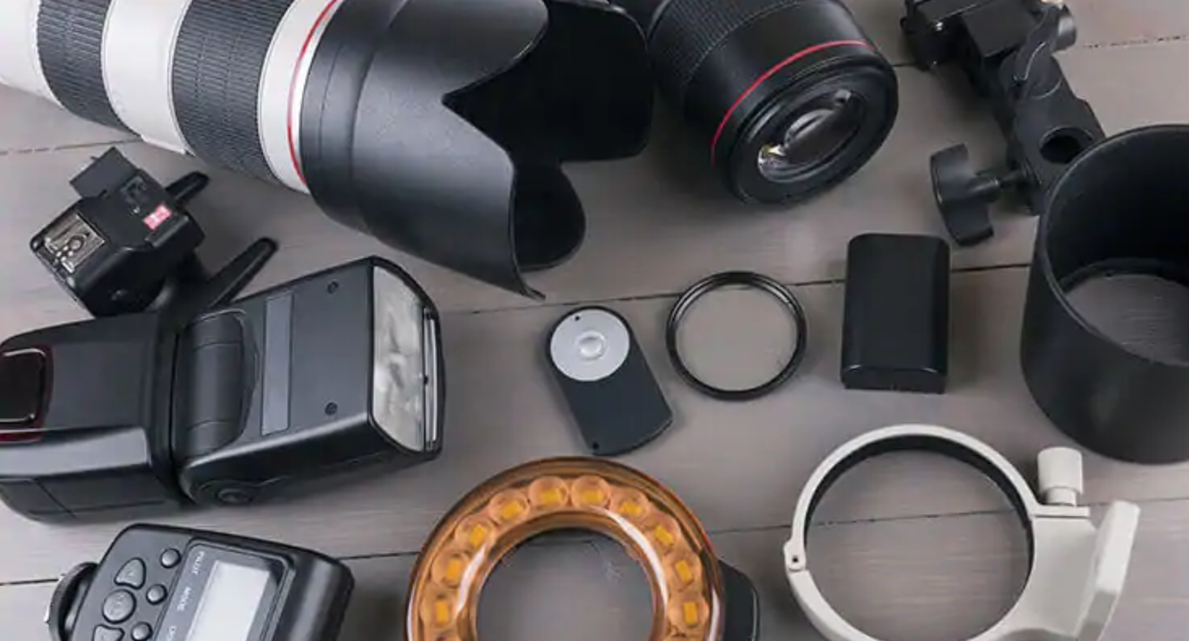
PFAS Uses (3)
Aviation industry - PFAS are used in manufacturing hydraulic fluids to prevent flammability, corrosion and evaporation.
Electric equipment - PFAS are used to make electronic devices water-repellent as well as reduce reflectivity of etching solutions used in semiconductor manufacturing.
Photographic equipment- PFAS increase light-sensitivity of imaging materials.
Other uses: PFAS are also used in polymer manufacturing, medical devices, building materials, oil and mining industries and agriculture.

Slide 8
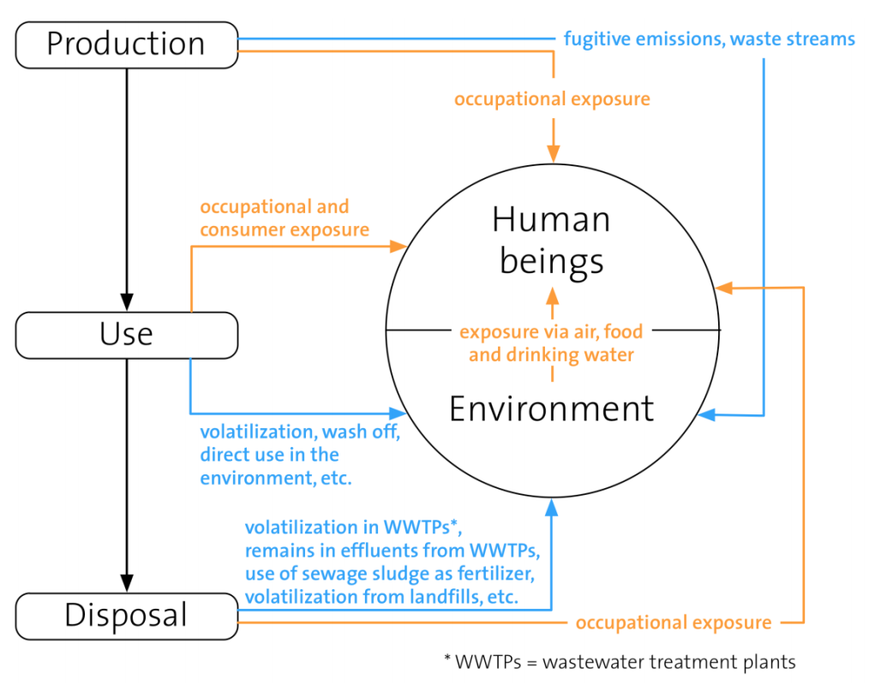
PFAS Environmental and Human Health Risks
Highly persistent in environment.
Risks of bioaccumulation in biota and humans
Toxic for reproduction, affecting immune system, and carcinogenic for human organism
Lifecycle of PFAS containing products and their potential harm
to environment and human beings

Slide 9
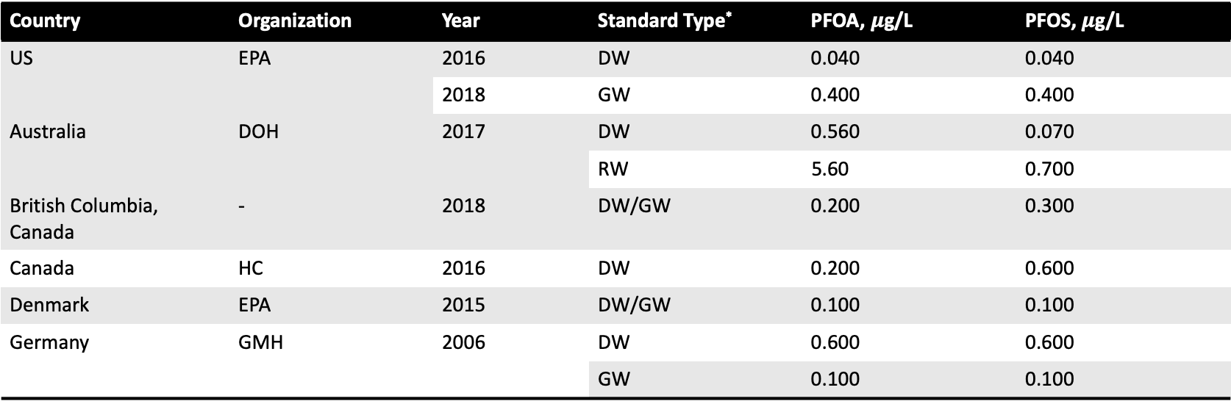
PFAS Water Regulations
Country | Organization | Year | Standard Type* | PFOA, $μ$g/L | PFOS, $μ$g/L
US | EPA | 2016 | DW | 0.040 | 0.040
 |  | 2018 | GW | 0.400 | 0.400
Australia | DOH | 2017 | DW | 0.560 | 0.070
 |  |  | RW | 5.60 | 0.700
British Columbia, Canada | - | 2018 | DW/GW | 0.200 | 0.300
Canada | HC | 2016 | DW | 0.200 | 0.600
Denmark | EPA | 2015 | DW/GW | 0.100 | 0.100
Germany | GMH | 2006 | DW | 0.600 | 0.600
 |  |  | GW | 0.100 | 0.100
*DW – drinking water; GW – ground water; RW – recreational water; FW – fresh water; SW – Surface water

Slide 10
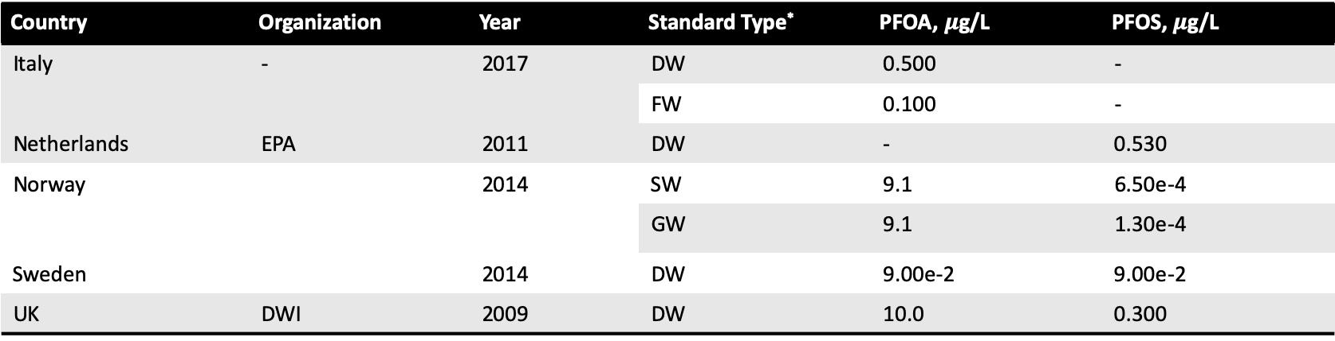
PFAS Water Regulations
Country | Organization | Year | Standard Type* | PFOA, $μ$g/L | PFOS, $μ$g/L
Italy | - | 2017 | DW | 0.500 | -
 |  |  | FW | 0.100 | -
Netherlands | EPA | 2011 | DW | - | 0.530
Norway |  | 2014 | SW | 9.1 | 6.50e-4
 |  |  | GW | 9.1 | 1.30e-4
Sweden |  | 2014 | DW | 9.00e-2 | 9.00e-2
UK | DWI | 2009 | DW | 10.0 | 0.300
*DW – drinking water; GW – ground water; RW – recreational water; FW – fresh water; SW – Surface water

Slide 11
PFAS Soil Regulations
Country | Organization | Year | Standard Type* | PFOA, mg/kg | PFOS, mg/kg
US | EPA | 2018 |  | 1.72e-4 | 3.78e-4
Australia | HEPA/DoEE | 2018 | Residential with garden | 0.100 | 9.00e-3
 |  |  | Residential w/o garden | 20 | 2
 |  |  | Public open space | 10 | 1
British Columbia, Canada |  | 2018 | RSL | - | 1
Canada | HC | 2019 | SSV | 0.7 | 2.1
Denmark |  | 2015 |  | 0.4 | 0.4
Norway |  | 2018 |  | 1.30e-2 | 2.30e-3
British Columbia, Canada |  | 2018 | RSL | - | 1
*RSL – regional screening level ; SSV – soil screening value

Slide 12
PFAS Liquid Treatment - Literature Review
There are several PFAS removal technologies in liquids:
  Sorption
    Granulated Activated-Carbon
    Biochar
    Ion exchange
  Precipitation/ Coagulation/Flocculation
  Redox Manipulation
  Membrane filtration
    Reverse osmosis
    Nanofiltration

Slide 13
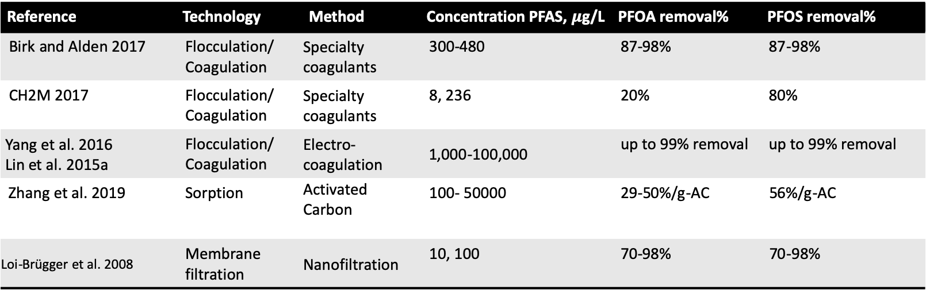
PFAS Liquid Treatment - Literature Review
Reference | Technology | Method | Concentration PFAS, $μ$g/L | PFOA removal% | PFOS removal%
Birk and Alden 2017 | Flocculation/ Coagulation | Specialty coagulants | 300-480 | 87-98% | 87-98%
CH2M 2017 | Flocculation/ Coagulation | Specialty coagulants | 8, 236 | 20% | 80%
Yang et al. 2016 Lin et al. 2015a | Flocculation/ Coagulation | Electro-coagulation | 1,000-100,000 | up to 99% removal | up to 99% removal
Zhang et al. 2019 | Sorption | Activated Carbon | 100- 50000 | 29-50%/g-AC | 56%/g-AC
Loi-Brügger et al. 2008 | Membrane filtration | Nanofiltration | 10, 100 | 70-98% | 70-98%

Slide 14
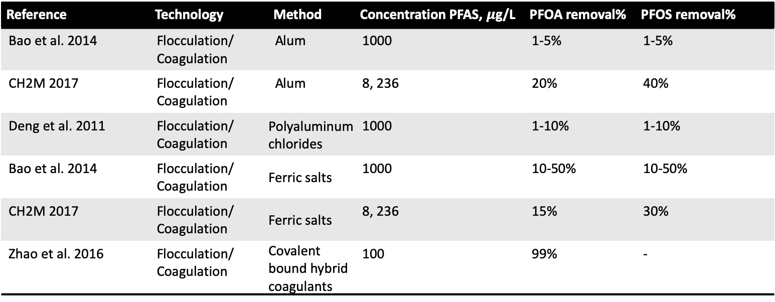
PFAS Liquid Treatment - Literature Review
Reference | Technology | Method | Concentration PFAS, $μ$g/L | PFOA removal% | PFOS removal%
Bao et al. 2014 | Flocculation/ Coagulation | Alum | 1000 | 1-5% | 1-5%
CH2M 2017 | Flocculation/ Coagulation | Alum | 8, 236 | 20% | 40%
Deng et al. 2011 | Flocculation/ Coagulation | Polyaluminum chlorides | 1000 | 1-10% | 1-10%
Bao et al. 2014 | Flocculation/ Coagulation | Ferric salts | 1000 | 10-50% | 10-50%
CH2M 2017 | Flocculation/ Coagulation | Ferric salts | 8, 236 | 15% | 30%
Zhao et al. 2016 | Flocculation/ Coagulation | Covalent bound hybrid coagulants | 100 | 99% | -

Slide 15
PFAS Liquid Treatment Resins - Literature Review
Reference | Resin name | Resin amount | Concentration PFAS, mg/L | PFOA removal, % | PFOS removal, % | Adsorption capacity, PFAS
Du et al. 2015 | IRA 67 | 0.2g/L | 120 | 88 | -
 |  | 1.5g/L | 120 | 90 | 90
Yao et al. 2014 | IRA 67 | 2mg/L | 50 | 96 | 100
 | IRA 400 | 2mg/L | 50 | 99 | 96
Deng et al. 2010 | IRA 67 | 50mg/L | 200 | - | - | 4-5mmol/g
 | IRA 958 | 50mg/L | 200 | - | - | 4-5mmol/g
Senevirathna et al. 2010 | Amb XAD 4 | 1g/L | 200 | 99 | 99
Gao et al. 2017 | IRA 67 | 5mg/L | 200 | - | 90%
Yu et al. 2009 | Polystyrene divinylbenzene | 50mg/L | 20-250 | 2.92mmol/g

Slide 16
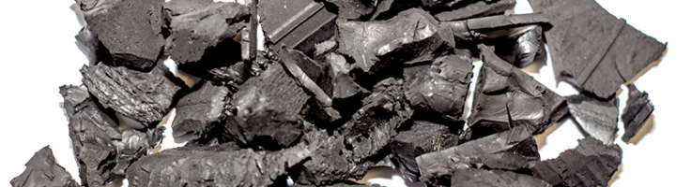
Potential of TDA for PFAS Removal
From the literature review, it is anticipated about 10~50% of PFOA and PFOS is removed by TDA.
In addition, TDA can remove phosphorus, oils, benzene, toluene, trichloroethylene, pesticides, etc.

Slide 17
Reference List:
https://www.kemi.se/en/global/rapporter/2015/report-7-15-occurrence-and-use-of-highly-fluorinated-substances-and-alternatives.pdf
https://sci-hub.se/10.1039/c8em00368h
https://pfas-1.itrcweb.org/wp-content/uploads/2018/03/pfas_fact_sheet_remediation_3_15_18.pdf
https://pfas-1.itrcweb.org/wp-content/uploads/2019/03/pfas-fact-sheet-afff-10-3-18.pdf
https://pfas-1.itrcweb.org/wp-content/uploads/2017/11/pfas_fact_sheet_history_and_use__11_13_17.pdf
https://pfas-1.itrcweb.org/wp-content/uploads/2018/01/pfas_fact_sheet_regulations__1_4_18.pdf
https://www.oecd.org/env/ehs/risk-management/PFC_FINAL-Web.pdf

