Slide 1
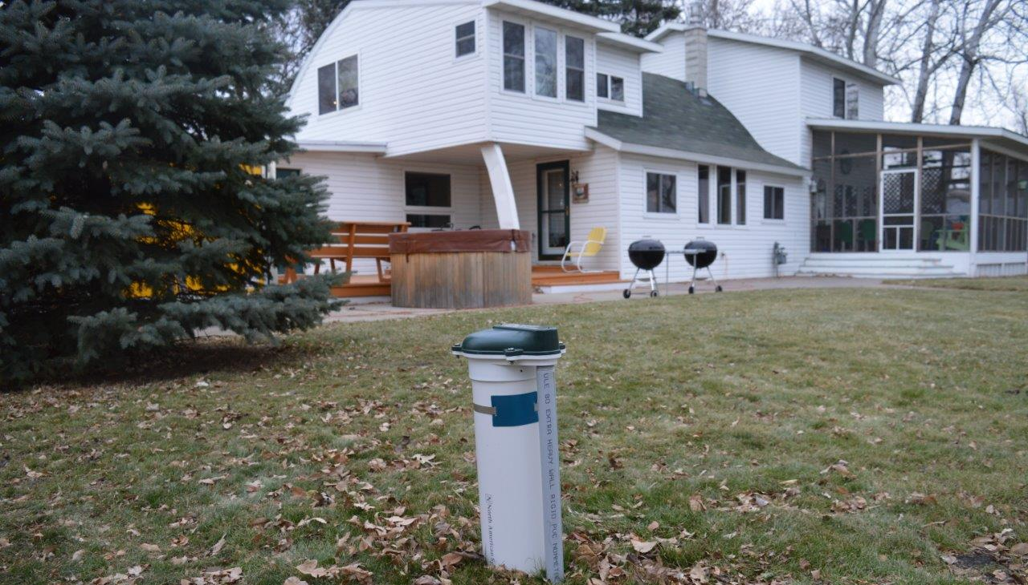


Private Well Protection
Chris Elvrum, Manager Well Management Section

Slide 2
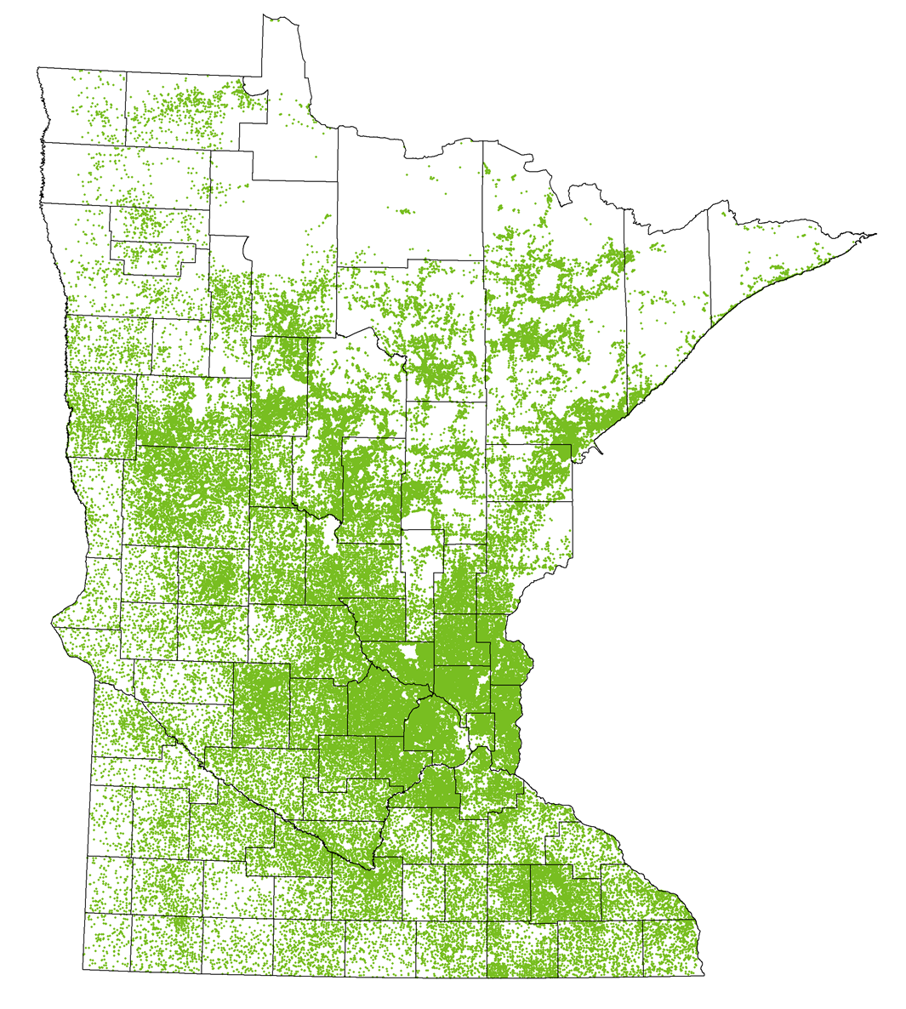
Private Well Users In Minnesota
21% of Minnesotans rely on a private well for drinking water
  1.2 million people
  450,000 households
Span a range of demographics

Slide 3
Goals
Private wells are a safe source of drinking water
Private wells are tested regularly
Private well water quality issues are addressed

Slide 4
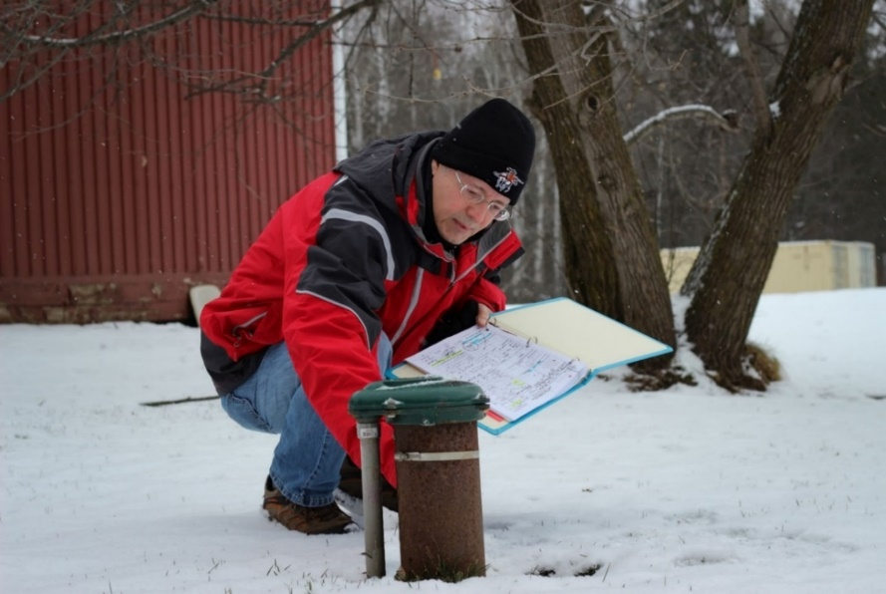
Minnesota’s Well Code
1974 – Protect public health and groundwater
Regulate the construction, maintenance and sealing of wells and borings
  Setbacks, materials, grouting etc.
License well contractors
  Continuing Education Credits
  Enforcement
Well testing at time of construction
  Bacteria - since 1975 - must pass test before well can be used
  Nitrate - since 1975
  Arsenic - since 2008
*Additional testing, treatment, and maintenance is up to the well owner

Slide 5
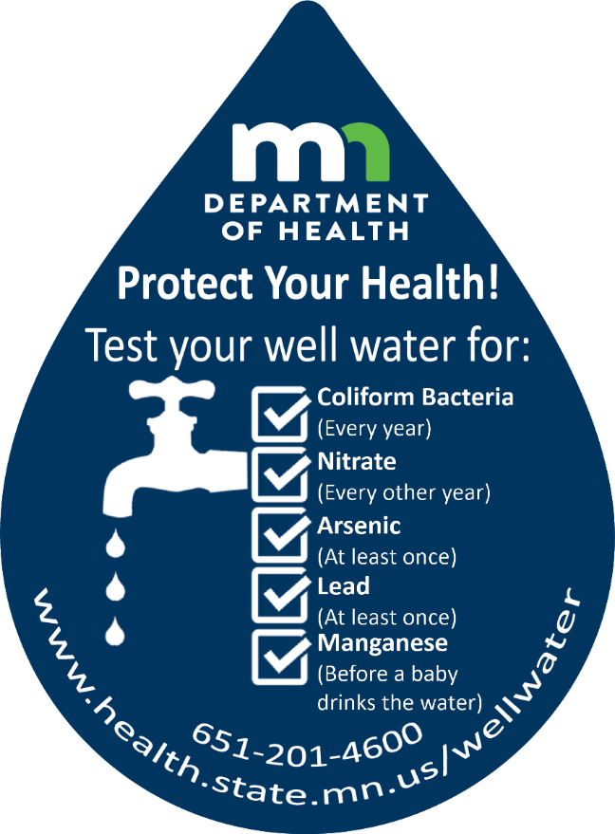
What should I test for?
Bacteria – Every year
Nitrate – Every other year
Arsenic – At least once
Lead – At least once
Manganese – Before a baby drinks the water

Slide 6
What are the concerns?
 | Bacteria | Nitrate | Arsenic | Manganese | Lead
Health effects | Indicates pathogens in water Diarrhea Vomiting Cramps | Affects how blood carries oxygen primarily in babies (blue baby syndrome) *above standard | Cancer risk Cardiovascular disease Reduced intelligence in children | Problems with Memory Attention Motor skills Learning Behavior | Damage to Brain Kidneys Nervous system Problems with Development Behavior
How common is it? | 27% (1996 CDC study) | ~1% (new wells)* ~4-5% (all wells)* >40% (in some townships)* | 11% (above standard) ~50% (have arsenic) | ~50% ? (above level safe for infants) | ?

Slide 7
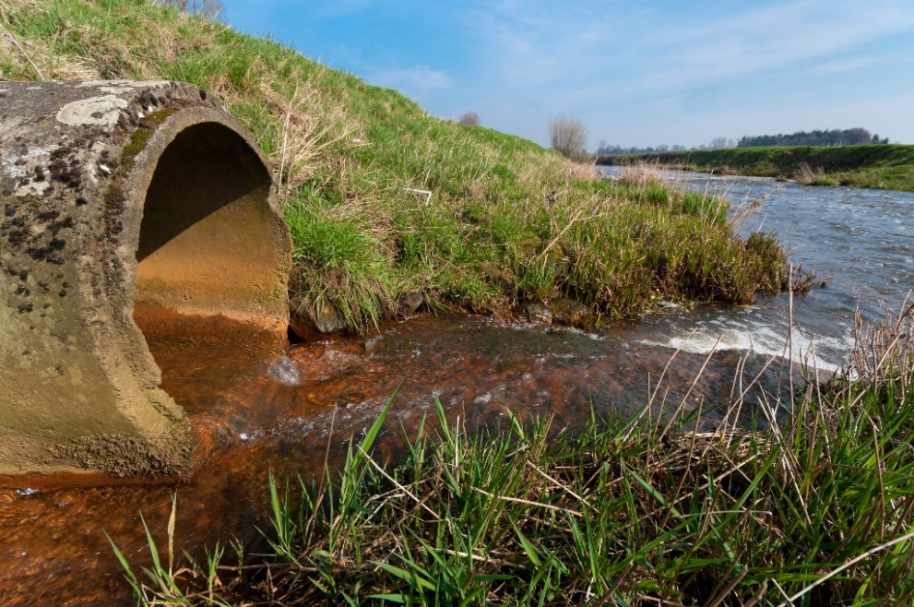
What else can a concern for private wells?
Industrial contaminants
  Trichloroethylene (TCE)
  Perfluoroalkyl and Polyfluoroalkyl Substances (PFAS)
  1, 4 Dioxane, VOCs
Contaminants of emerging concern
  Personal care products
  Pharmaceuticals
  Pesticides
  Industrial chemicals
  Disinfection byproducts
  Naturally occurring (radium, boron, fluoride)

Slide 8
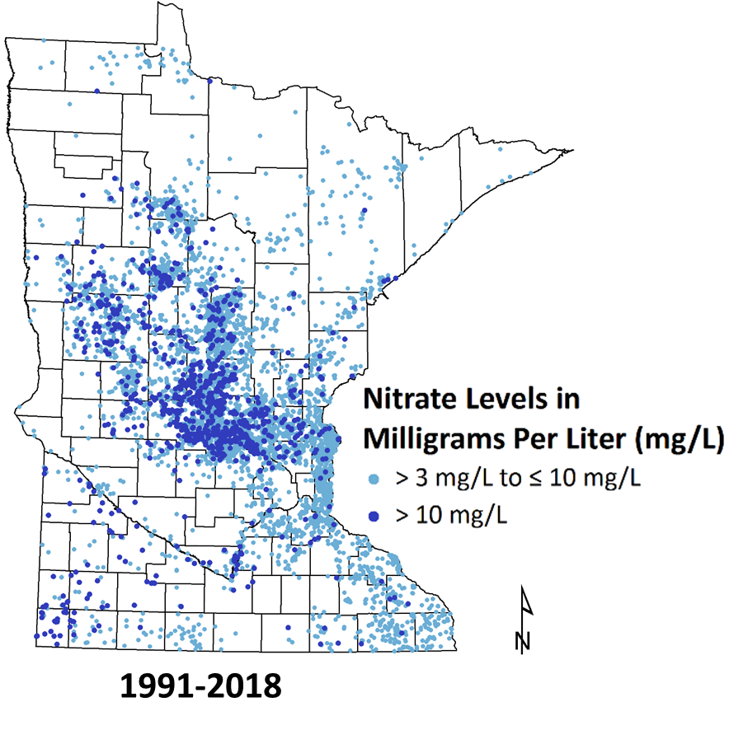
Nitrate in Newly Constructed Wells
Primarily affects babies under 6 months.
371 babies per year potentially at risk of drinking water with nitrate above 10 mg/L.
Assumptions
14,490 babies on private wells
(69,000 births statewide; 21% on private wells)
9,274 possibly using formula from a well at 6 months
(36% of babies are breastfed at 6 months)
371 babies per year are possibly consuming water with nitrate above 10 mg/L
(~4% of all wells have nitrate above 10 mg/L)

Slide 9
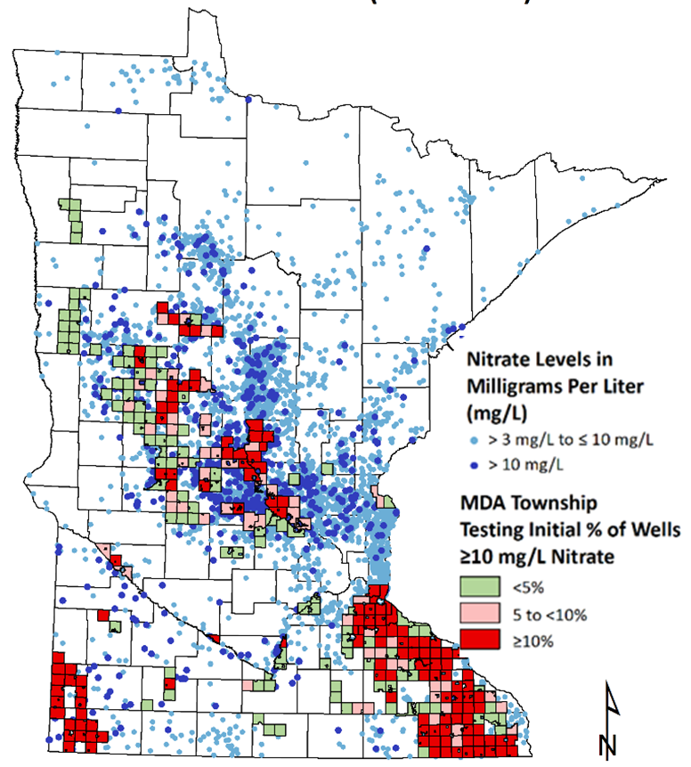
Wells with Nitrate >10 mg/L
 | MDA Township Testing (wells in highly vulnerable areas) | New Well Data (wells constructed according to well code)
Central Sands | 15% | 5%
Karst Area | 16% | 0.2%
Constructions methods and setbacks help in all areas
Special conditions* exist for wells constructed in limestone or dolomite (karst rocks)
*Must have more than 50 feet of non-limestone or dolomite above the aquifer for 1 mile radius around the well

Slide 10
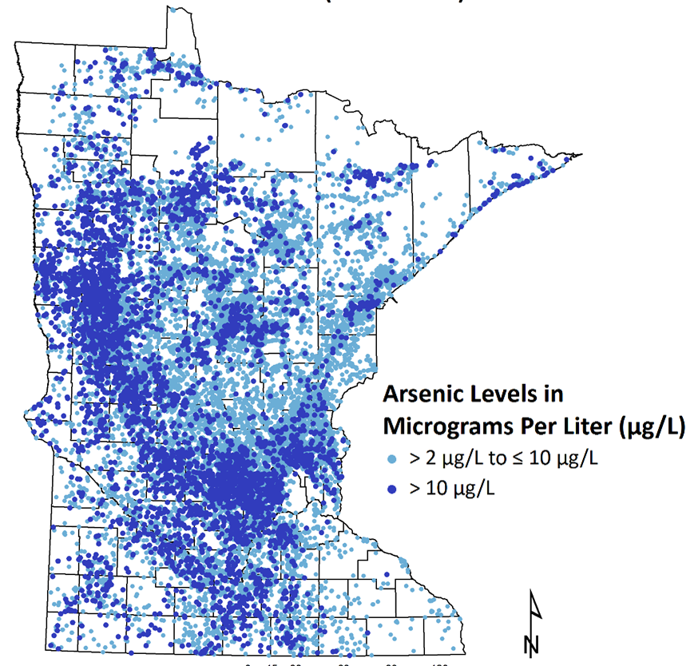
Arsenic in Newly Constructed Wells
11% of new wells are above 10 µg/L
Increased cancer risk affects everyone, early life exposure increases risk
132,000 people with concentrations above 10 µg/L
Risk exists below 10 µg/L
Estimated number of lifetime cancer (bladder and lung) cases from arsenic in private wells: 2,400
Neurological, cardiovascular, pulmonary, liver, endocrine, and reproductive affects from arsenic as well
Notes:
About 11% of new wells exceeds 10 ug/L (similar for all wells)
Increased cancer risk affects everyone, early life exposure increases risk
132,000 people with increased cancer risk >10 ug/L
Risk exists below 10 ug/L
Estimated number of lifetime cancer (bladder and lung) cases from As in private wells = 2,400
Neurological, cardiovascular, pulmonary, liver, endocrine and reproductive affects from As as well

Slide 11
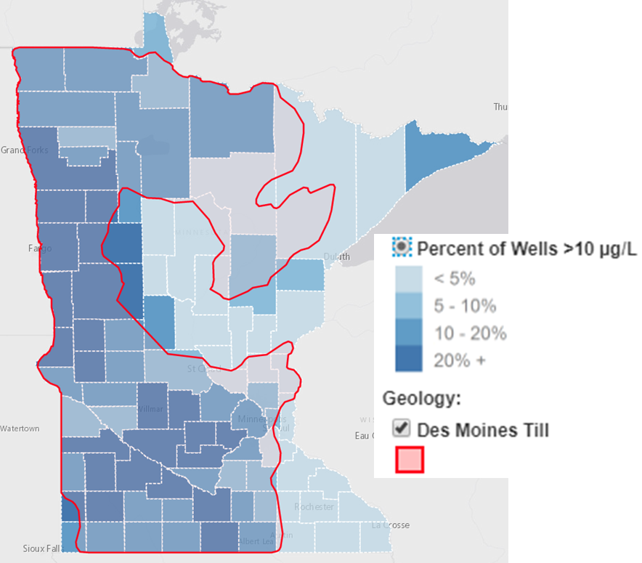
Arsenic in Newly Constructed Wells (continued)
Arsenic occurrence loosely correlated with the Des Moines Lobe Till
Occurs more in the clayey confining layers
Difficult to predict based on location and neighboring wells
The well code does little prevent arsenic

Slide 12
Arsenic
In 2003, the U.S. EPA lowered the arsenic Maximum Contaminant Level (MCL) from 50 to 10 µg/L.
National Health and Nutrition Examination Survey (NHANES) concluded that between 2003 and 2014 arsenic in urine decreased 17% for those on public water supplies but no change for private well users.

Slide 13
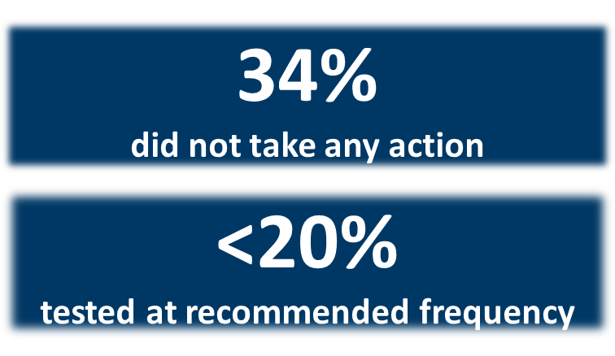
Are people taking action to ensure safe drinking water?
2016 survey of 798 well owners who had arsenic above 10 µg/L in their new well sample
Notes:
We did not have a clear understanding of whether people are taking action to ensure their well water is safe to drink.
In 2016, we sent a survey to nearly 4,000 households that get their drinking water from private wells that have levels of arsenic above the level allowed in public drinking water systems.
798 households participated in the survey and answered questions about demographic information, actions they’ve taken to reduce their exposure to arsenic, and general well stewardship practices.
Survey results showed that while 36 percent installed a water treatment system and 25 percent switched to drinking bottled water, there were still 34 percent of respondents who did not take any form of action to reduce their exposure to unsafe levels of arsenic in their drinking water.
Survey results also showed that less than 20 percent of the respondents had tested their well water within the past two years. MDH recommends well users test their well water every year for coliform bacteria, every other year for nitrate, and at least once for arsenic and lead.
[CLICK] We are now working to develop and implement evidence-based strategies to address the issues identified in the survey as impeding people from testing their well water and reducing their exposure to unsafe contaminants.

Slide 14
Key Findings: Why Actions Were Not Taken
Reason | %
Not concerned about arsenic level | 50
Was not sure what to do or whom to contact | 21
Treatment options too expensive | 15
Treatment systems too difficult to use and maintain | 15
Haven’t gotten around to it, but plan to | 11
Other | 16
Arsenic level is…
Typical for the area
Too low to be dangerous
Would decrease with time
Some did not take action because of misinformation
Multiple selections allowed
Notes:
Top reason for no action was lack of concern about arsenic (risk perception)
Other studies have found that perceived lack of risk was an important factor in not testing one’s well as well.
Wasn’t sure….health literacy barrier.
Treatment…perceived barriers to treatment
“Other”: Some respondents took no action because well or home contractor said not to worry because arsenic level was:
Typical for the area
Too low to be dangerous
Would decrease with time

Slide 15
Key Findings: Prompts for Well Testing
How important would the following factors be in prompting you to test your well?
Prompt | % ‘Very Important’
Change in taste, smell, appearance of water | 80
Recommendation of a doctor | 59
Unexplained health problems | 55
Infant or young child living in/visiting home | 50
Well testing event occurring in township/county | 50
Hearing from a neighbor about a water quality problem in my area | 49
Coupon for a discount on a well water test | 47
Selling my home | 35
Recommendation of a town official | 31
Notes:
We asked participants how important ten factors would be in prompting them to test their well water (“very important”, “somewhat important”, “not important”. Assume prompts that are “Very important” would be most likely to result in testing. Aside from change in taste/smell/appearance of water, the top ranking “very important” prompt was “Recommendation of a doctor”. Traditional outreach strategies (news articles, public official recommendations) had the lowest “Very important” ranking.
Doctor result not surprising: Recent Pew Research Center survey asked U.S. adults how much they trust a variety of information sources. Health care providers ranked higher than family and friends, local new organizations, and government sources. Survey result supports role of health care providers as valuable advocates. We have not taken advantage of the fact that health care providers are trusted messengers of EH information.
Some differences between groups:
Hearing from a neighbor: Higher income/education; younger age
Coupon: Lowest income group; younger age
More likely to rate these as “very important”

Slide 16




Where do people go for information?
Group | Information source
All | Water testing laboratory (43%)
>60 years old <College degree <$60,000 | Well driller (31%) Extension (27%)
<60 years old ≥College education >$60,000 | General internet search (39%) local websites (32%)
Notes:
Other sources
Water treatment company=22%
Friend, relative, neighbor=13%
Health clinic=8%
Federal government website=5%

Slide 17
Equity
What motivates people to test or treat varies by education, income, and age
Income is a predictor of installing home water treatment
People with an income >$100,000 are twice as likely to install treatment compared to people with an income <$40,000.
People with incomes <$40,000 were five times as likely to select cost as the reason for not taking action.
Notes:
Where would you look for info to help manage the safety & quality of your well water? (select top 3 of 11 choices)
Most commonly selected info source (excluding MDH website):
Local govt. ranked 2nd or 3rd for most age, education, and income groups
Oldest age group, lowest education group, and lower income groups selected well driller more often than local govt.

Slide 18
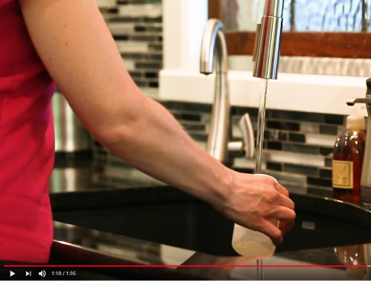
What are we doing? Education and Outreach Activities
Updating website and materials
  Over 175 partners ordered more than 32,000 brochures since May 2018
Created laboratory toolkit to promote well testing
  24 downloads since July 2019
Social media posts
  Reached over 65,000 in 2019
YouTube videos (testing, inspecting, sealing, flooding)
  Over 1,500 views since December 2019
Continuing education for well contractors and real estate professionals
  All well contractors attend
  243 real estate professionals provided input on content

Slide 19




What else? Testing Assistance
Stearns County
SWCD, Lab, WIC partnership
221 test kits
UMN Water Resources Center
15 septic system and private well classes
Over 150 test kits so far
Becker and Otter Tail Counties
SWCD, WIC, Family Home Visiting, lab partnership
Kits distributed through WIC and Family Home Visiting (in process)
In-Home Childcare
Continuing Education credit and video
Free well testing (in development)

Slide 20
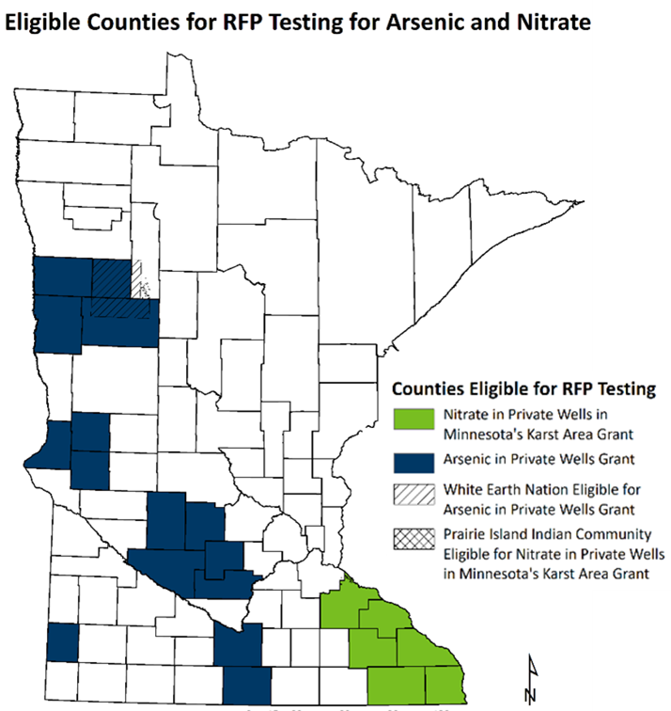
Pilot RFP Testing/Mitigation
Request for Proposals posted February 4, 2020
Two grants available to local governments in:
  Karst area (nitrate)
  Western Minnesota (arsenic)
$100,000 each
  Free or low cost testing
  Mitigation for eligible* households
* Eligibility will be determined with the grantee, related to household income or other factors

Slide 21
Questions?
chris.elvrum@state.mn.us
651.201.4598

