Slide 1
“Sea-level” Rise in the Twin Cities?
The Slow-Motion Groundwater Flood Has Arrived
Ray Wuolo
Barr Engineering Co.

Slide 2
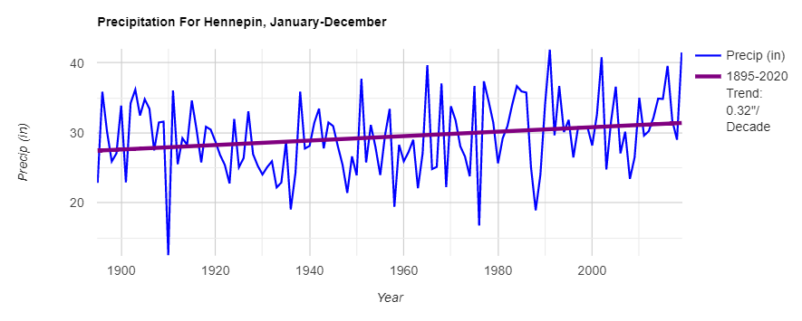
2019 was a record year for precipitation
plot of annual precipitation since 1895 shows
long-term increase of 1/3-inch per decade

Slide 3
what happens when precipitation falls on the ground?
most rainfall is used by plants or runs off to lakes and streams
some rainfall seeps downward, below the root zone of plants (infiltration)
infiltration eventually migrates to the water table – this is “recharge”
precipitation
evapotranspiration
runoff
runoff
infiltration
recharge
water table

Slide 4
recharge potential is greatest in late-Fall and early Spring
fall rain
before
frozen ground
frozen
ground
spring rain
and snow melt
growing season
winter spring summer fall

Slide 5
recharge to the water table will increase when…
annual precipitation increases
precipitation exceeds evapotranspiration (plant) demands
evapotranspiration is low (non-growing season) and soil is not frozen
deep soil moisture is high from previous year/season
high-intensity rainfall events MAY increase recharge IF runoff accumulates in depressions

Slide 6
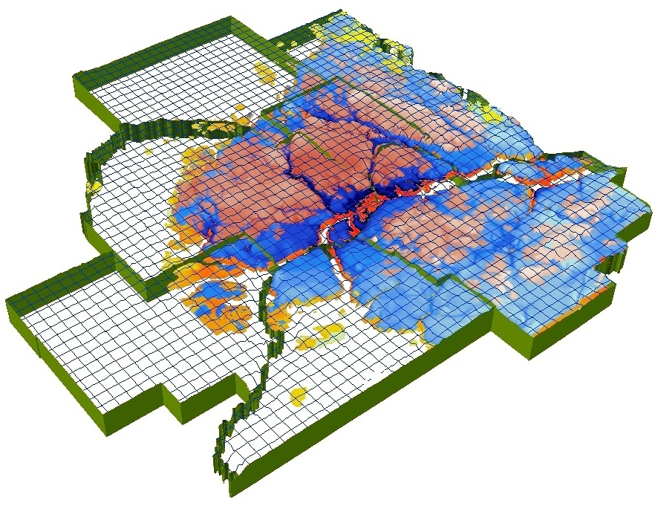


Metro Model 3 groundwater model used to evaluate recharge
model covers 11 County metro area
includes all aquifers
models the effects of changing weather and water use on groundwater levels

Slide 7
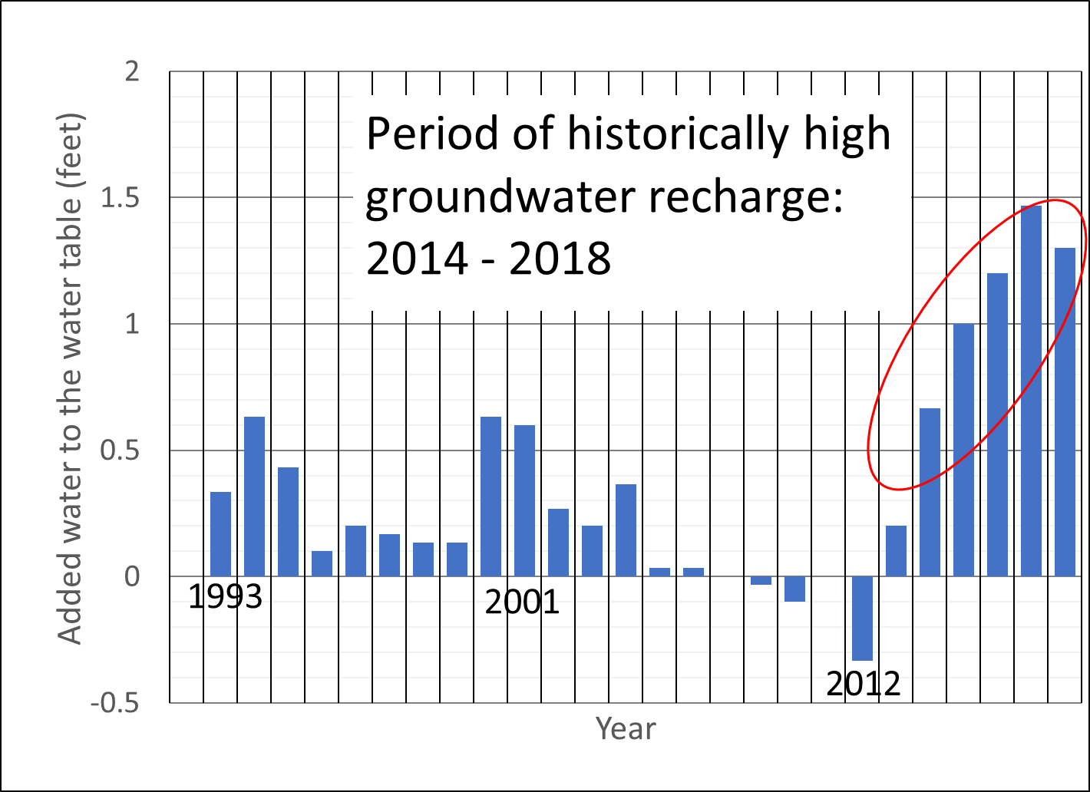
recharge has added 1 to 1.5 feet to the water table in the south Minneapolis in the last few years
compared to 1992

Slide 8
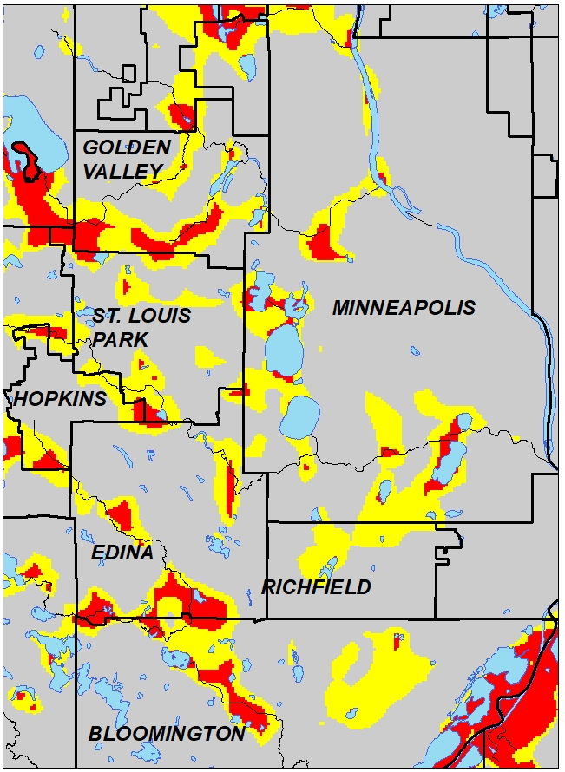
we can now reliably predict areas where the water table will be shallow
DEPTH TO
WATER TABLE
less than 10 feet
10 to 20 feet
map showing areas where water table is shallow in Minneapolis and nearby western suburbs

Slide 9

we can also predict where shallow water table conditions have expanded since 2010
DEPTH TO
WATER TABLE
less than 10 feet
expansion of
10-20 ft area
since 2010
10 to 20 feet
map showing areas where water table is shallow in Minneapolis and nearby western suburbs

Slide 10
what are the potential consequences of a rising water table?
perennially higher lakes, streams and wetlands
increases frequency and severity of floods from rain and snow melt
basements and underground infrastructure were built when the water table was lower
  foundation failures
  mold issues
  infiltration and damage to underground piping
  reduced storm-sewer capacity
  greater freeze-thaw issues (pavement etc.)

