Slide 1
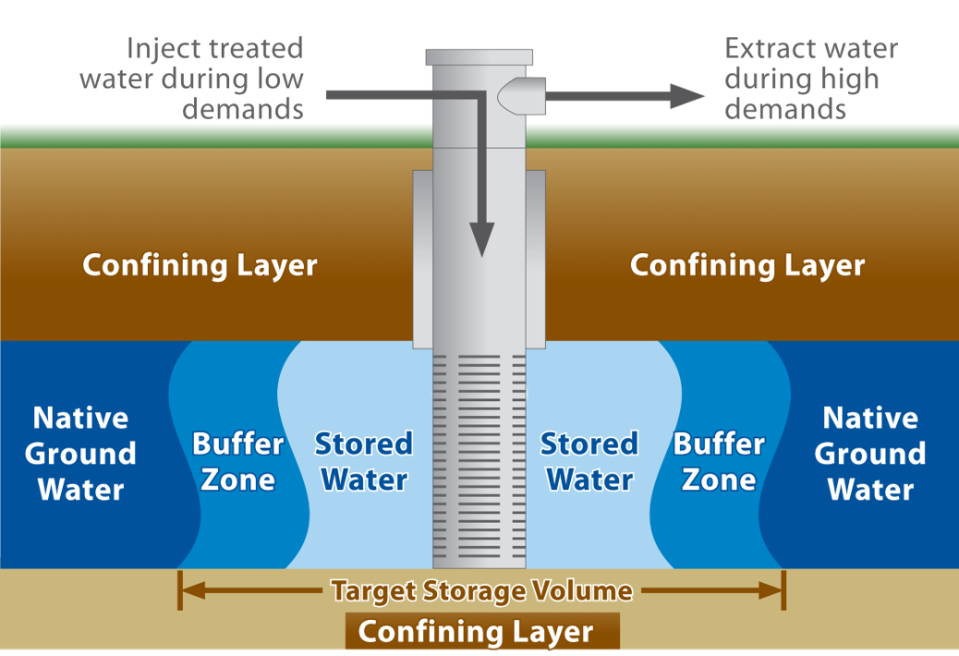
Banking Groundwater through Aquifer Storage and Recovery

Slide 2
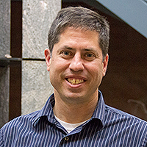
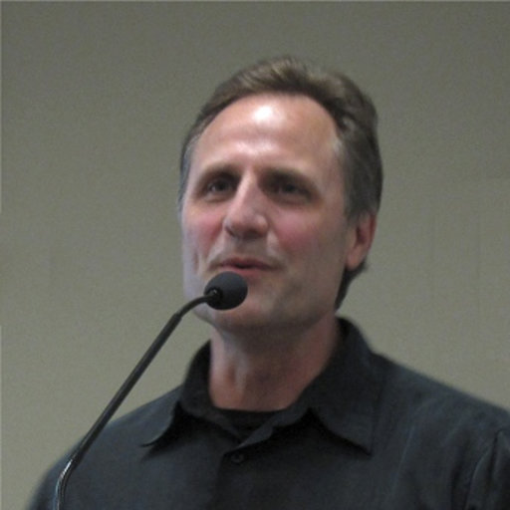
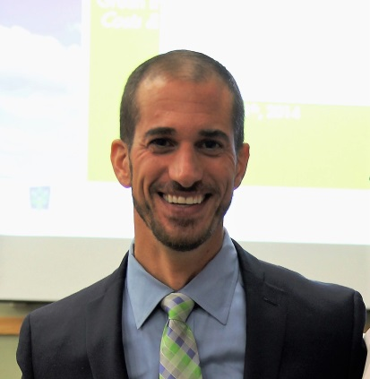
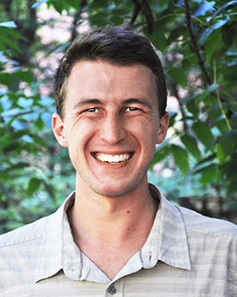
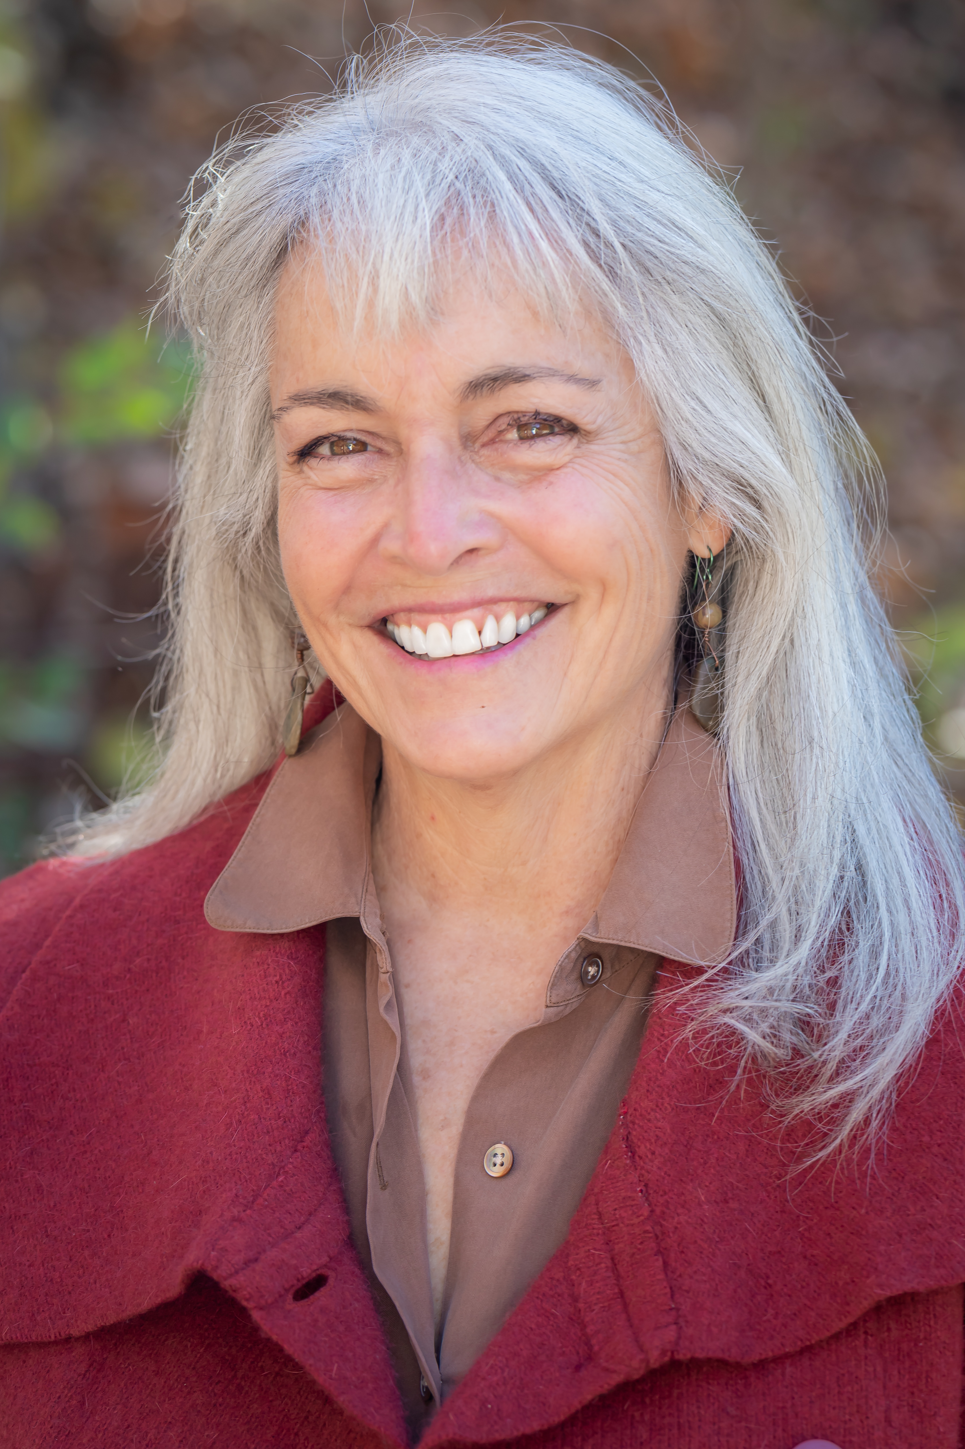
The core team
William Arnold
Distinguished McKnight University Professor Civil, Environmental and Geological Engineering
Jeffrey Peterson
Director
Water Resources Center
Lucia Levers
Research Associate
Water Resources Center
Peter K. Kang
Assistant Professor & Gibson Chair of Hydrogeology
Earth and Environmental Sciences
Tony Runkel
Senior Scientist
Minnesota Geological Survey
John Bilotta
Senior Research and Extension Coordinator
Brian Bohman
Research Fellow
Freshwater
Carrie Jennings
Research and Policy Director
Freshwater

Slide 3
Motivation
Who do you share your groundwater with?
Will there be enough?

Slide 4
Obvious First Steps
Encourage conservation
Eliminate barriers to water re-use
Some areas may still come up short

Slide 5
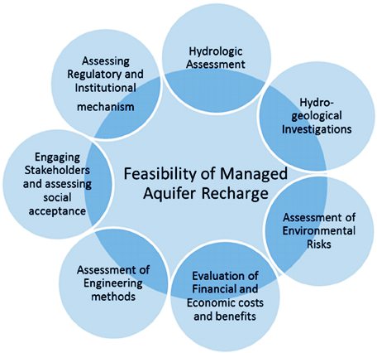
Overlapping Study Components
Arshad, Guillaume and Ross, Water 2014, 6, 2748-2769; doi: 10.3390/w6092748

Slide 6
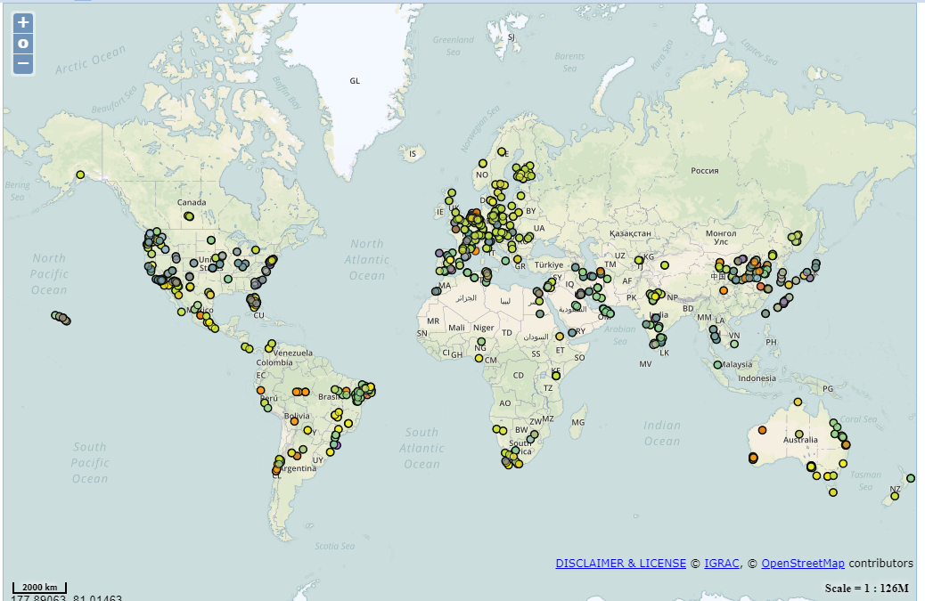
Aquifer Recharge Around the World
https://apps.geodan.nl/igrac/ggis-viewer/viewer/globalmar/public/default

Slide 7
Why ASR?
creating reliable seasonal water sources
meeting peak demand without building a larger treatment plant
making water reserves less vulnerable to contamination
conserving land area used for water storage
sustaining groundwater-fed ecosystems like trout streams, lakes and fens.

Slide 8
Estimating Injection Capacity of an Aquifer

Slide 9
Injection Scenarios

Slide 10
Woodbury Example
Population = $72,828$
Water use =119 $\frac{gal}{d} =0.45m^{3}$
Water requirement for Woodbury = $0.45×72,828=32, 773 m^{3}$
Injection capacity (90 percentile value) = $380,000 m3 (30 days)$
# of days per month of injection = $\sim$ $11 days$
# of wells required for 3 months $\sim$ $9$ wells

Slide 11
Identified barriers
Sufficient and organized aquifer pump test data
State authority for injection from EPA
Clear permitting path by MDH
Coordination among agencies regulating groundwater (MDH, MPCA, DNR)
City leading needs assessment

Slide 12
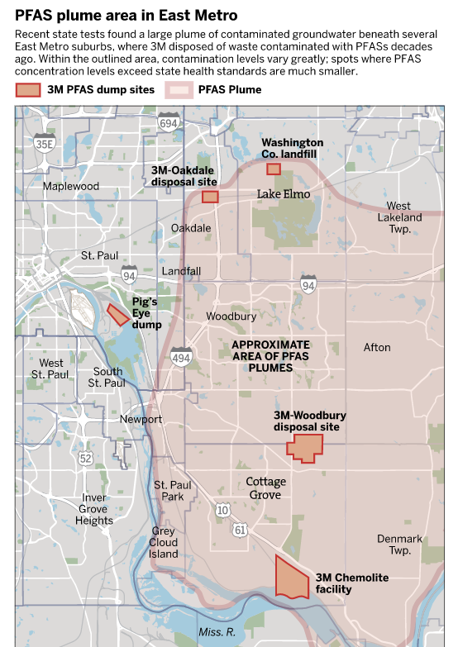
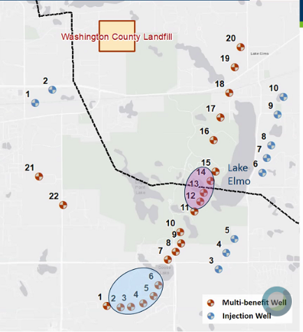
ASR role in PFAS remediation is being explored
Potential pumping and injection well array. Source: Wood Consulting Group and MPCA
Source: Star Tribune

