Slide 1
MMA Primary Care Physician Workforce Expansion Advisory Task Force Final Report & Recommendations
Legislative Health Care Workforce Commission
Meeting
July 22, 2014

Slide 2
Primary Care Physician Workforce Shortage

Slide 3
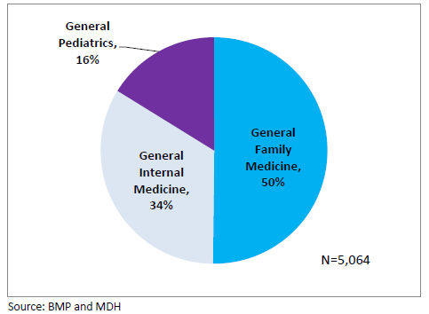
Primary Care Physician Mix in Minnesota (2011-2012)
Source: Minnesota’s Primary Care Workforce (2011- 2012), MDH, Office of Rural Health and Primary Care

Slide 4
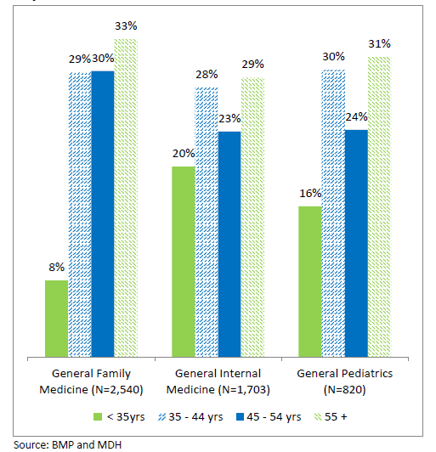
Age Distribution of Primary Care Physicians in Minnesota
Source: Minnesota’s Primary Care Workforce (2011- 2012), MDH, Office of Rural Health and Primary Care

Slide 5
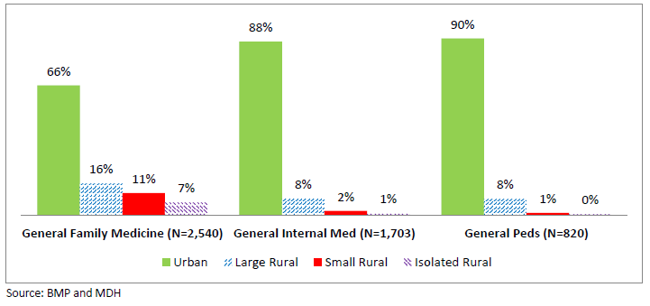
Rural - Urban Distribution
Source: Minnesota’s Primary Care Workforce (2011- 2012), MDH, Office of Rural Health and Primary Care

Slide 6
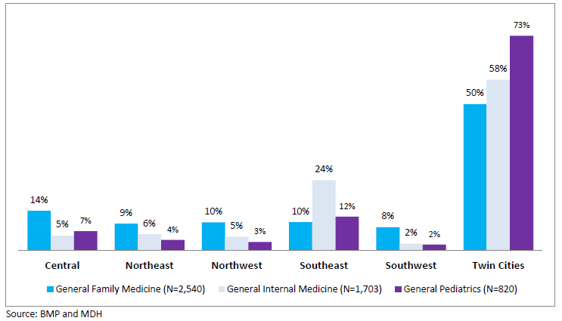
Regional Distribution
Source: Minnesota’s Primary Care Workforce (2011- 2012), MDH, Office of Rural Health and Primary Care

Slide 7
Projected Shortage
In the U.S., a shortage of 45,000 primary care doctors by 2020
By 2025, shortage projected to grow to 65,000 primary care doctors
Source: Association of American Medical Colleges

Slide 8
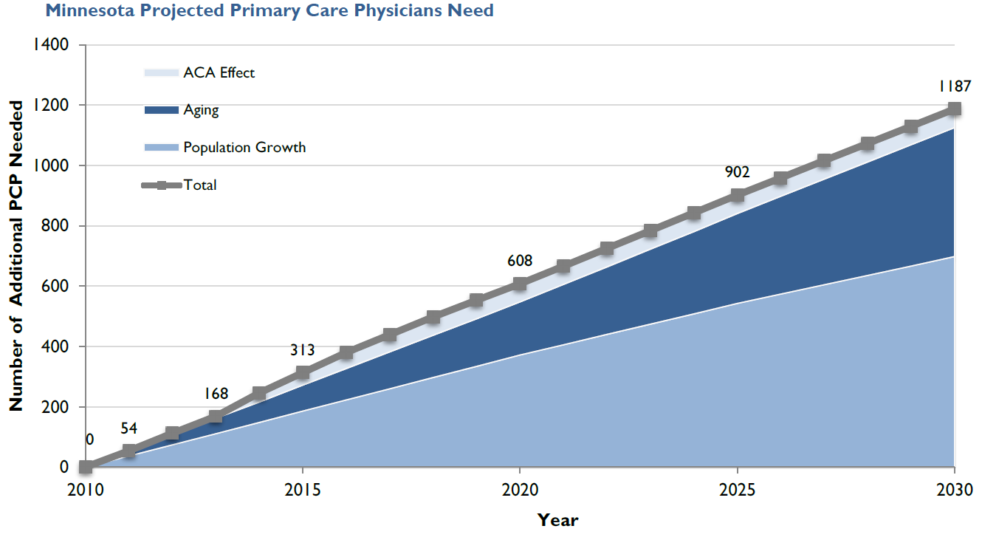
Source: Robert Graham Center, Minnesota – Projecting Primary Care Physician Workforce, 2013

Slide 9
Factors Influencing Shortage – Aging Population
Between 2000 and 2030, the portion of Minnesota’s population that is 65 and older is expected to increase from 12% to 24%.
Source: Governor’s Workforce Development Council (Minnesota – December 2011)

Slide 10
Factors Influencing Shortage – Aging Workforce
U.S: In 2010, one quarter of the 242,000 primary care physicians in the U.S. were 56 or older.
Minnesota: In 2011, more than a third of primary care physicians were 55 or older.
Source: Health Affairs, March 28, 2013; Advancing Primary Care, Council on GME, December 2010; Minnesota Department of Health, Office of Rural Health and Primary Care

Slide 11
Additional Factors
Growing Population
Affordable Care Act
Decreases in state funding for medical education
A steady or decreasing number of primary care physician residency slots
Declining interest in primary care careers

Slide 12
Task Force Background

Slide 13
MMA Strategic Plan
MMA’s five year strategic plan
Three primary goals:
Helping Minnesotans Become the Healthiest in the Nation
Making Minnesota the Best Place to Practice Medicine
Advancing Professionalism in Medicine
Helping Minnesotans Become the Healthiest in the Nation
Expanding the primary care physician workforce

Slide 14
Task Force Summary
Membership
14 physicians
Meetings
6 meetings (May 2013 – March 2014)
May 2014 MMA Board of Trustees Meeting
Final report and recommendations approved
July 2014 MMA Board of Trustees Meeting
Implementation work plan submitted

Slide 15
Task Force Charge
Understand the various drivers affecting the capacity and future supply of Minnesota's primary care physician workforce.
Identify strategies - at all levels of medical education and training and within practice settings - for increasing Minnesota's primary care physician workforce.
Determine roles for the MMA, as well as for other potential stakeholders, in advancing specific strategies to increase Minnesota's primary care physician workforce.
Recognize the relationship between primary care physician workforce expansion efforts and other non-physician primary care workforce initiatives.
Partner with others, as needed, to increase the visibility and importance of the issue of Minnesota's primary care physician workforce capacity among policy makers and the public.

Slide 16
Task Force Deliverables
Plan and convene a summit
Recommend to the MMA Board of Trustees MMA policy positions
Develop a set of action steps that will launch community action

Slide 17
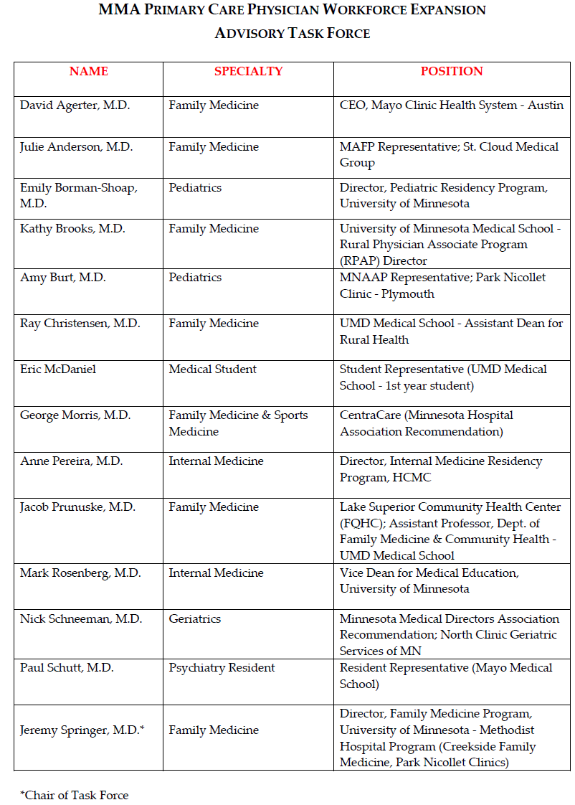
Membership

Slide 18
Task Force Efforts

Slide 19
Definition of Primary Care Physician
“A primary care physician serves as a patient’s first point of contact with the health care system. This primary care physician continues to provide comprehensive care for a patient, collaborating or consulting with other health professionals when such a need arises. In Minnesota, this type of care is generally provided by practitioners in the specialties of family medicine, general internal medicine, general pediatrics, and geriatrics.”

Slide 20
Barriers to Expanding the Primary Care Physician Workforce
Primary care income differential compared to other specialties
Perception of primary care among medical students
Lifestyle challenges
Limited residency slots
Access to meaningful clinical experiences
Cultural support for primary care within medical schools
Hassles for physicians associated with training (in regards to the challenges that preceptors face in training medical students)
Geographic maldistribution of primary care physicians
Unsupportive comments/experiences provided to students by primary care preceptors
Uncertainty about the future of primary care

Slide 21
Surveys
Medical Students (Perception of Primary Care)
Schools: University of Minnesota Medical School and Mayo Medical School
Total Students Surveyed: 1011
Total Responses: 142
Sample positive responses: PCPs can build long-term relationships with patients; PCPs are able to manage chronic health issues.
Sample negative responses: Poor compensation; prefer to know ONE field really well; uncontrollable hours
Clinical Preceptors (Role of Preceptor)
25 physicians interviewed
Preceptors and Non-Preceptors
Metro and Out-State
Length of service as preceptor: 2 years to over 35 years
Reasons to Serve: Enjoy teaching; Important role
Challenges: Time Commitment

Slide 22
Primary Care Physician Workforce Summit

Slide 23
Summit Summary
Objectives
Bring physicians together to discuss ways to solve the primary care physician workforce shortage.
Educate physicians on the current state of the workforce shortage.
Examine ways to transform physicians’ practice in order to reinvigorate primary care.
Keynote Speaker: Scott A. Shipman, MD, MPH, Director of Primary Care Affairs and Workforce Analysis, Association of American Medical Colleges (AAMC)
Closing Speaker: Paul H. Rockey, MD, MPH, Scholar in Residence, Accreditation Council for Graduate Medical Education (ACGME)
Panel Discussions
Economics and Business Side of Primary Care
Current State of Medical Education in Minnesota
Primary Care Practice Transformation

Slide 24
Task Force Recommendations

Slide 25
Recommendation for Highest MMA Priority
The Minnesota Medical Association will work with health systems, hospitals, large practices and the state’s medical schools to examine ways to increase the number of available clinical training sites in Minnesota, and examine ways to remove barriers that exist in allowing medical students to have more meaningful experiences.

Slide 26
Minnesota State Legislative Package
The Minnesota Medical Association will address the high cost of medical school and the resulting medical school debt by supporting efforts that target loan forgiveness and loan repayment programs specifically to primary care, and that restores funding to levels equal to or greater than those of 2008.
The Minnesota Medical Association will support efforts to sustain beyond 2014 the ACA-required Medicaid payment bump for primary care, which increases primary care Medicaid rates to Medicare levels for 2013-2014.

Slide 27
The Minnesota Medical Association will further examine the feasibility of seeking a waiver from the Centers for Medicare & Medicaid Services (CMS) that would provide for state management of GME distribution in Minnesota. For example, the waiver could link GME funding to Minnesota’s primary care physician workforce needs and set up a distribution mechanism.
The Minnesota Medical Association will promote the creation by the state legislature of a state medical education council that includes a representative from each of the state’s medical schools, representatives from teaching hospitals and clinical training sites, and other relevant stakeholders. The council would serve the purpose of providing analysis and policy guidance on how Minnesota can meet its physician workforce objectives.

Slide 28
Federal (AMA) Legislative Package
(1) The Minnesota Medical Association will advocate that the 2011 Budget Control Act cuts to funding for Medicare-supported graduate medical education (GME) be restored and maintained at levels prior to the sequestration, which took effect in April 2013.
(2) The Minnesota Medical Association should take a leadership role in advocating for an adequate number of residency slots, adequate number of faculty and adjunct faculty support, and the required resources to increase the number of primary care residency slots.

Slide 29
MMA Policy Position – No Action Required
The Minnesota Medical Association acknowledges the role that income plays in specialty choice and believes that primary care physician capacity could be improved if this disparity was addressed.

Slide 30
Questions

