Slide 1
Legislative Health Care Workforce Commission
Overview
Mark Schoenbaum
Minnesota Department of Health
July 22, 2014

Slide 2
“Many policy levers that affect the supply, distribution and skill mix of the health workforce are state-based, including licensure and scope of practice regulations, state loan repayment programs, and Medicaid reimbursement rates.
State-level decisions about whether to enact or change policies directed at training, recruiting, and retaining health professionals affect a wide range of stakeholders….”
Dr. Erin Fraher, Director of the North Carolina Health Professions Data System

Slide 3
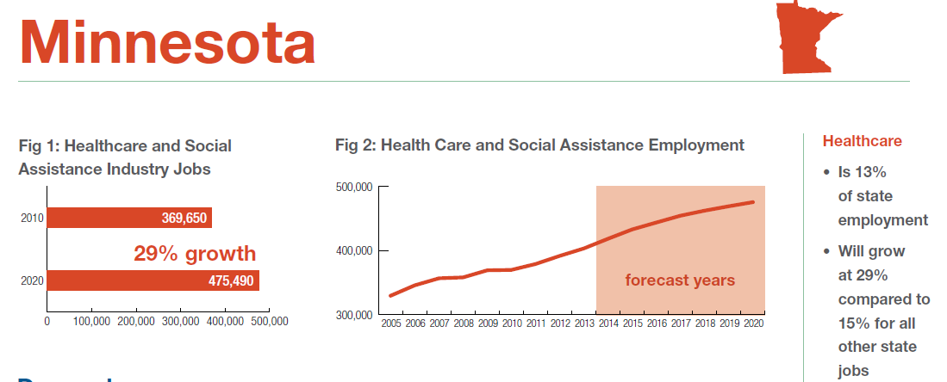
What makes up the Health Care Workforce?
Current Health Care Employment; Projected Growth
Carnivale AP, Smith N, Gulish A, Beach BH. Health Care. Georgetown University Center on Education and the Workforce, 2012.

Slide 4
Planning Framework
Need X workers ( MD, RN, lab tech, etc.) per year to meet demand
Demand factors: age, population growth, changes in coverage, etc.)
Expect Y workers per year
Through production (education and training)
Relocation/in-migration
Leaving a Gap of Z workers
Strategies to fill the gap:
Investments/incentives (federal, state, employer, higher ed, etc)
Role of technology & delivery system redesign
Regulatory changes

Slide 5
Health Workforce Development Pipeline
Prepare K-12 students in basic science & expose to health careers and role models
Locate education and training programs in high need settings & use relevant curricula
Encourage grads to seek employment in high need settings
Re-design health care delivery & health care jobs
Recruit traditional & non -traditional students
Retain the health care work-force

Slide 7
Types of Approaches
Understand Impacts of Current Investments
Commission Charge 2
Strategies:
Already underway – continue as is
Revise or redirect current resources
No (direct) cost strategies - regulatory & system changes
New or expanded funding required
Provide encouragement – e.g., best practices, innovative models, etc.
Which pipeline sections to address?

Slide 8
Health Workforce Analysis Framework
%

Slide 9
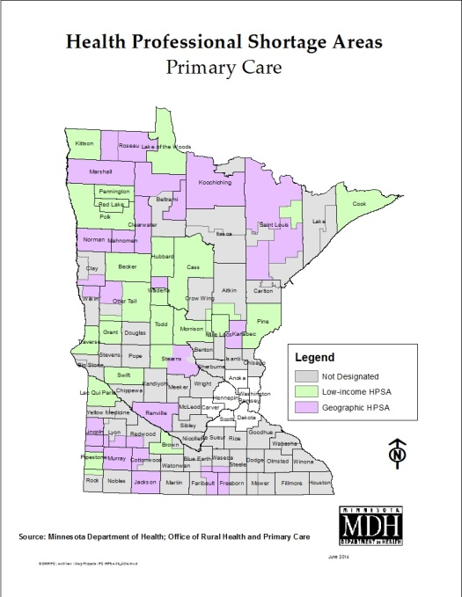
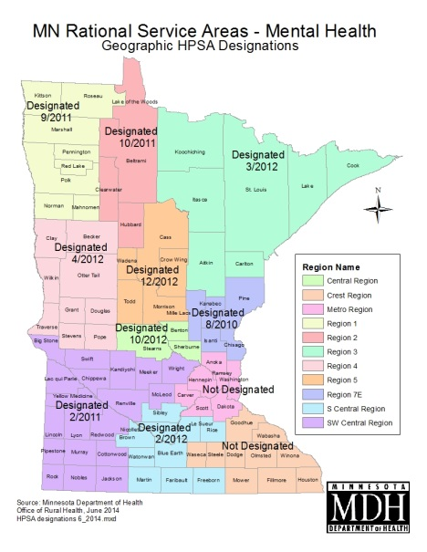
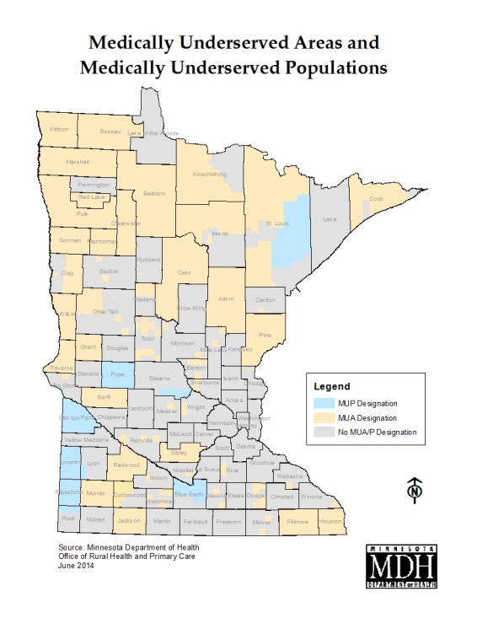
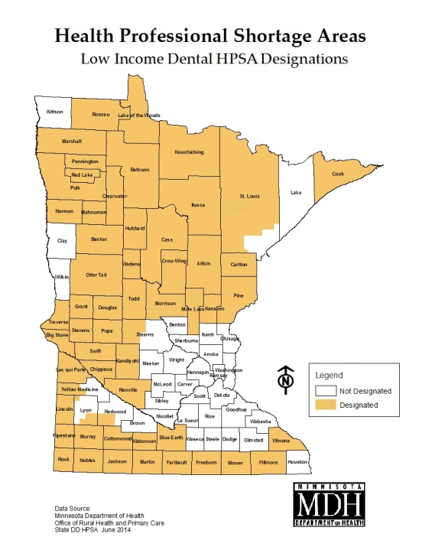
Minnesota’s Health Professional Shortage Areas

Slide 10
Why Primary Care?
Better health outcomes
Higher patient satisfaction
Lower health care spending.

Slide 13
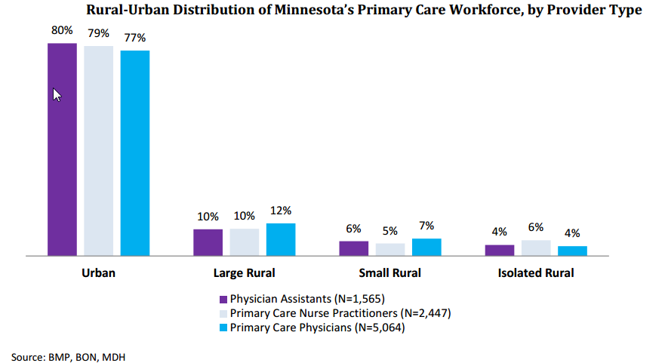
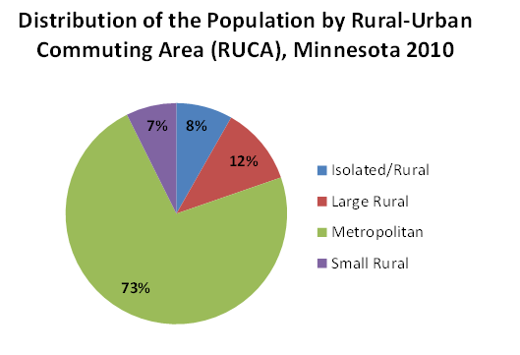

Slide 15
How big a shortage in MN?
MDH: 1,000 – 3,000 primary care physicians
U of M: 803, all MD specialties
Robert Graham Center – 1,187 primary care physicians
Georgetown – 1,000 - 4,000 all MD specialties
Assoc. of Amer. Medical Colleges: 90,000 nationally
Shortages in long term care, lab & imaging techs, other ancillary jobs, etc.

Slide 16
Related efforts
Governor's Health Care Reform Task Force
MMA Primary Care Task Force
U of M report to Higher Ed Committees
NGA Health Workforce Policy Academy
Mental Health Workforce Summit
Foreign-trained Physician Task Force

Slide 17
Mental Health Occupations
Mental Health Specialists Requiring Bachelor’s, Professional, or Advanced Degrees
Child, Family, and School Social Workers
Clinical, Counseling, and School Psychologists
Healthcare Social Workers
Marriage and Family Therapists
Mental Health and Substance Abuse Social Workers
Mental Health Counselors
Psychiatrists
Clinical, Counseling, and School Psychologists
Substance Abuse and Behavioral Disorder Counselors
Psychologists, All Other
Mental Health Specialists Requiring Less than a Bachelor’s Degree
Psychiatric Aides
Psychiatric Technicians

Slide 18
Current Government-Supported Providers
State Loan Forgiveness | 64 Primary Care MDs, Midlevels, Pharmacists
Federal Loan Forgiveness | 112 Primary Care providers ( + mental health & dental)
Joint State/Federal Loan Forgiveness | 7
Foreign Medical Grad MDs | 89 total (52 primary care, 37 specialists)
Total obligated providers | 250

Slide 19
Practice Re-design
Scope of Practice
Emerging Professions

Slide 20
Emerging Health Professions in MN
Licensed or certified by the state
Reimbursed by Medicaid
Community Health Workers (2007)
Dental Therapists (2008 - 09)
Community Paramedics (2011 -12)
Doulas (2013)

Slide 21
Contact Information
Mark Schoenbaum
mark.schoenbaum@state.mn.us , 651-201-3859

