Slide 1



Water-Level Changes in Lakes in the Northeast Metro: Why do they differ?
Perry M. Jones, Jared J. Trost, Aliesha Diekoff, and Melinda L. Erickson
Notes:
This is the first of two presentations on a 3-year cooperative study characterizing gw and sw interactions in selected lakes in the NE TCMA. I would like to recognize Met Council and MDH for their cooperation in the study, and my co-authors Jared Trost, Aliesha Diekoff, and Melinda Erickson.
This first presentation is describes two components of our study: a statistical analysis of lake-level data and field study of GW/SW interactions, focusing on White Bear Lake.

Slide 2
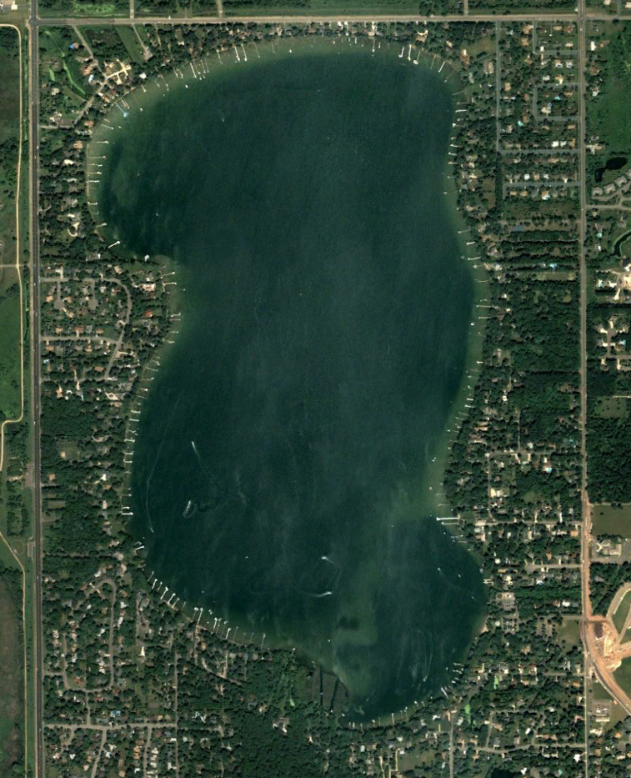
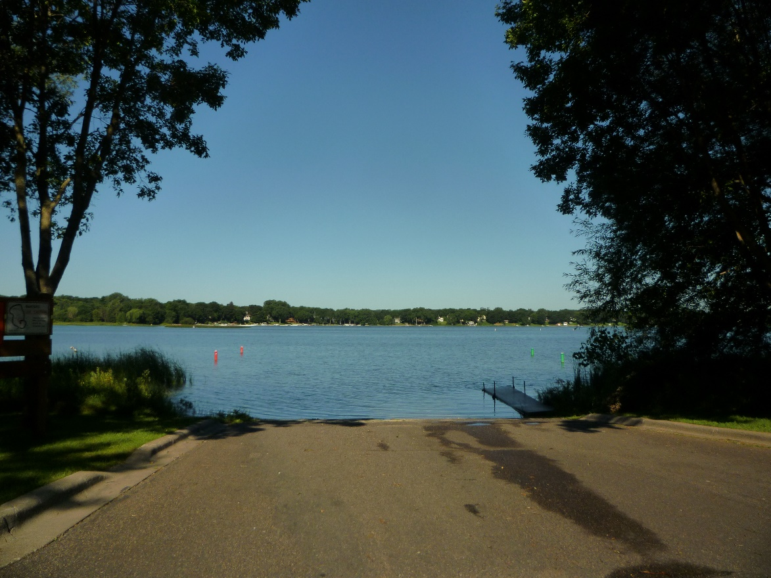
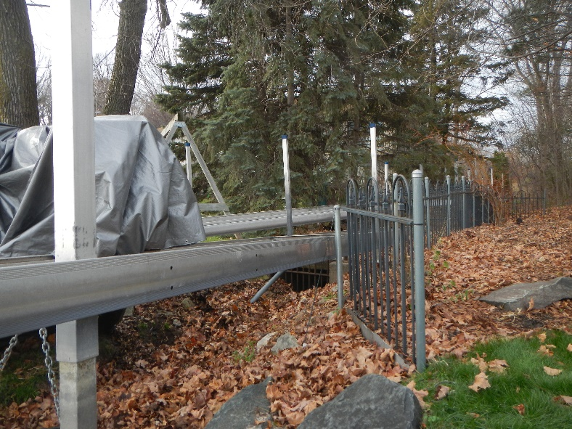
Water-Level Changes in Northeast Metro Lakes
Example: Turtle Lake

Slide 3
Water-Level Changes in Turtle Lake, 2000-2017
Water levels
Ordinary High
Water Level
2000
2003
2006
2009
2012
2015
2018
Year
Annual Precipitation Relative to Normal (inches)
Year

Slide 4
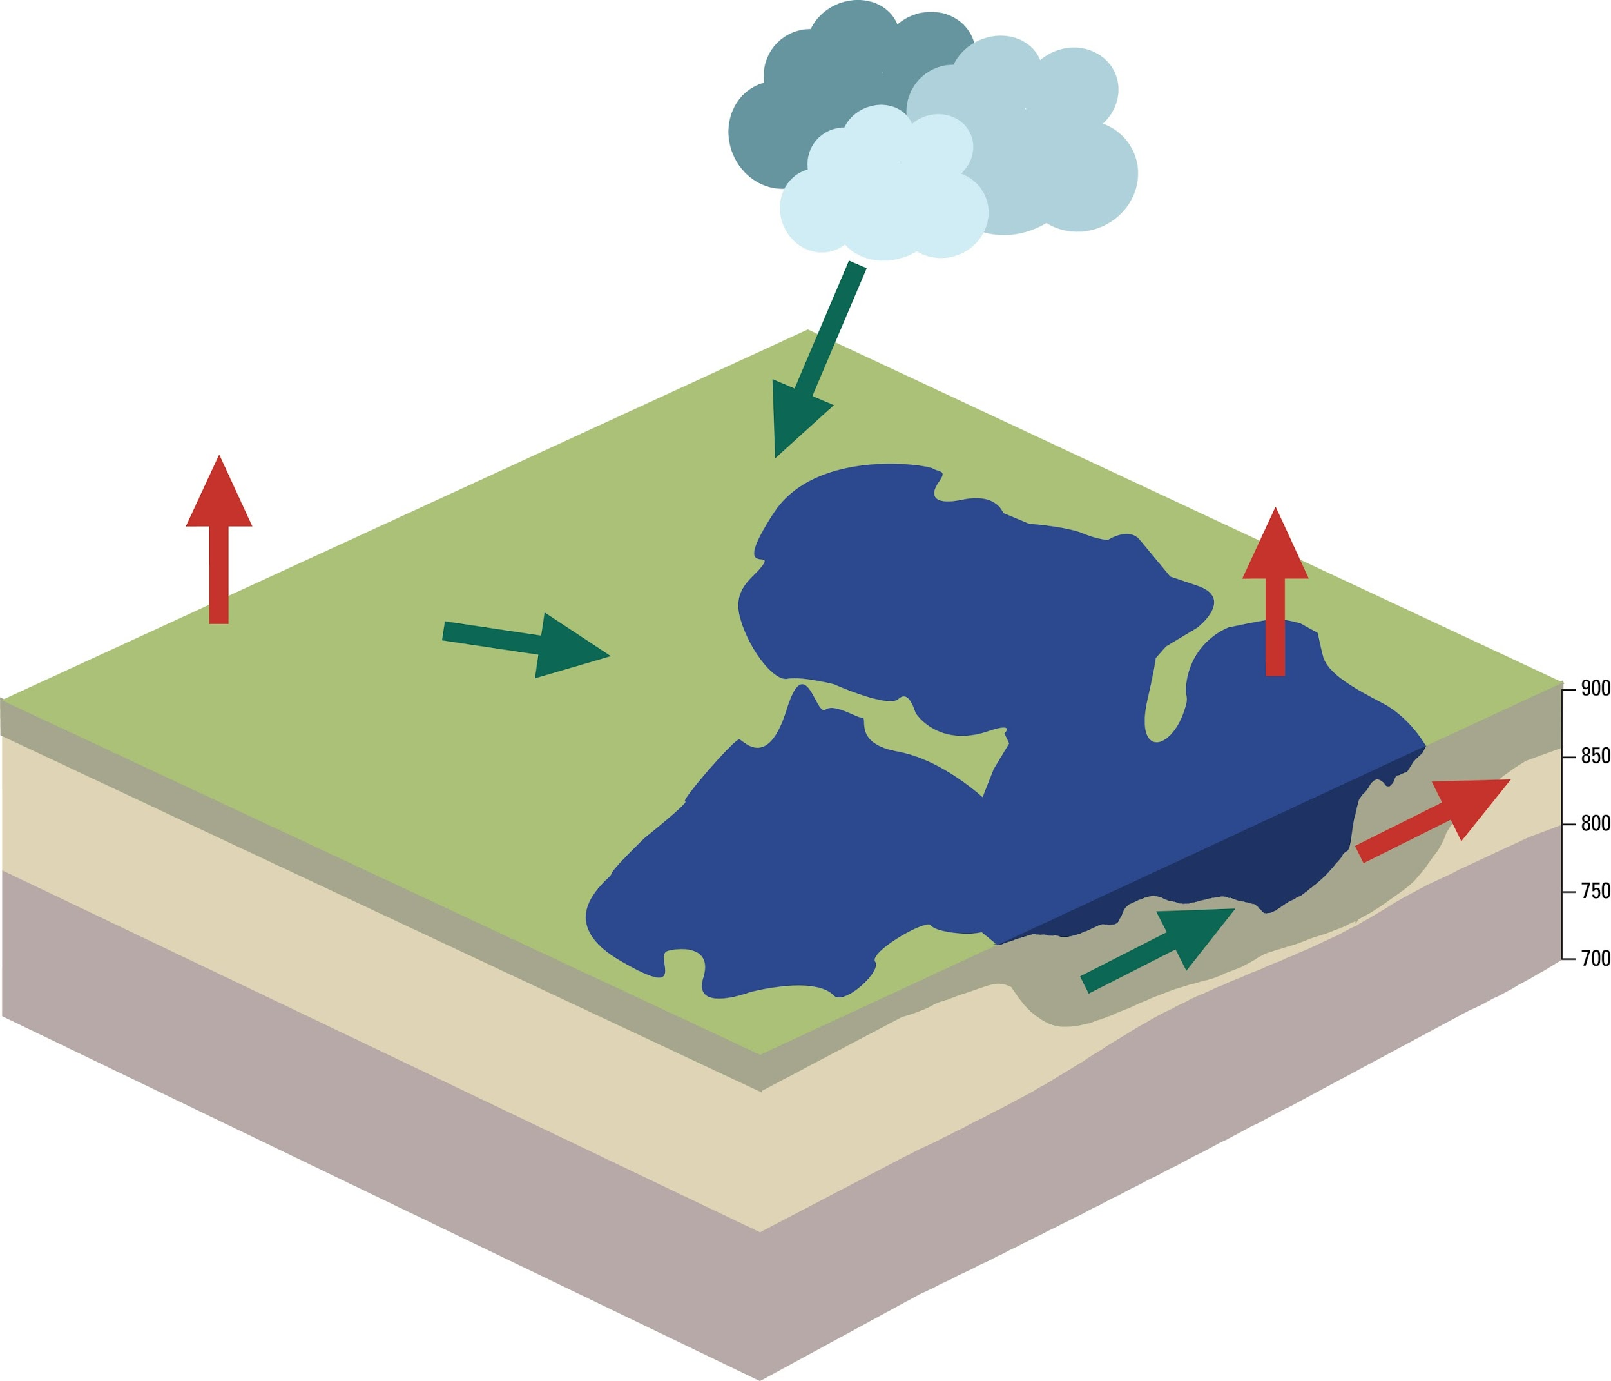

General Closed Lake Water Budget
Precipitation
Plant Transpiration
Evaporation
Surface-water Runoff
Well
Shallow Aquifer
Lake water
Outflow
Deep Aquifer
Groundwater
Inflow
Notes:
To understand why lake-water levels change, you need to understand the components of the lake-water budgets and factors that control these components, including the amount of groundwater and surface-water interactions or exchanges.
Just like a checking account, you need to total the water losses and gains to a lake to understand the final balance. You need to determine the contribution of each component to the lake-water budget to assess lake-water level variability and the factors controlling the contributions of each component.

Slide 5
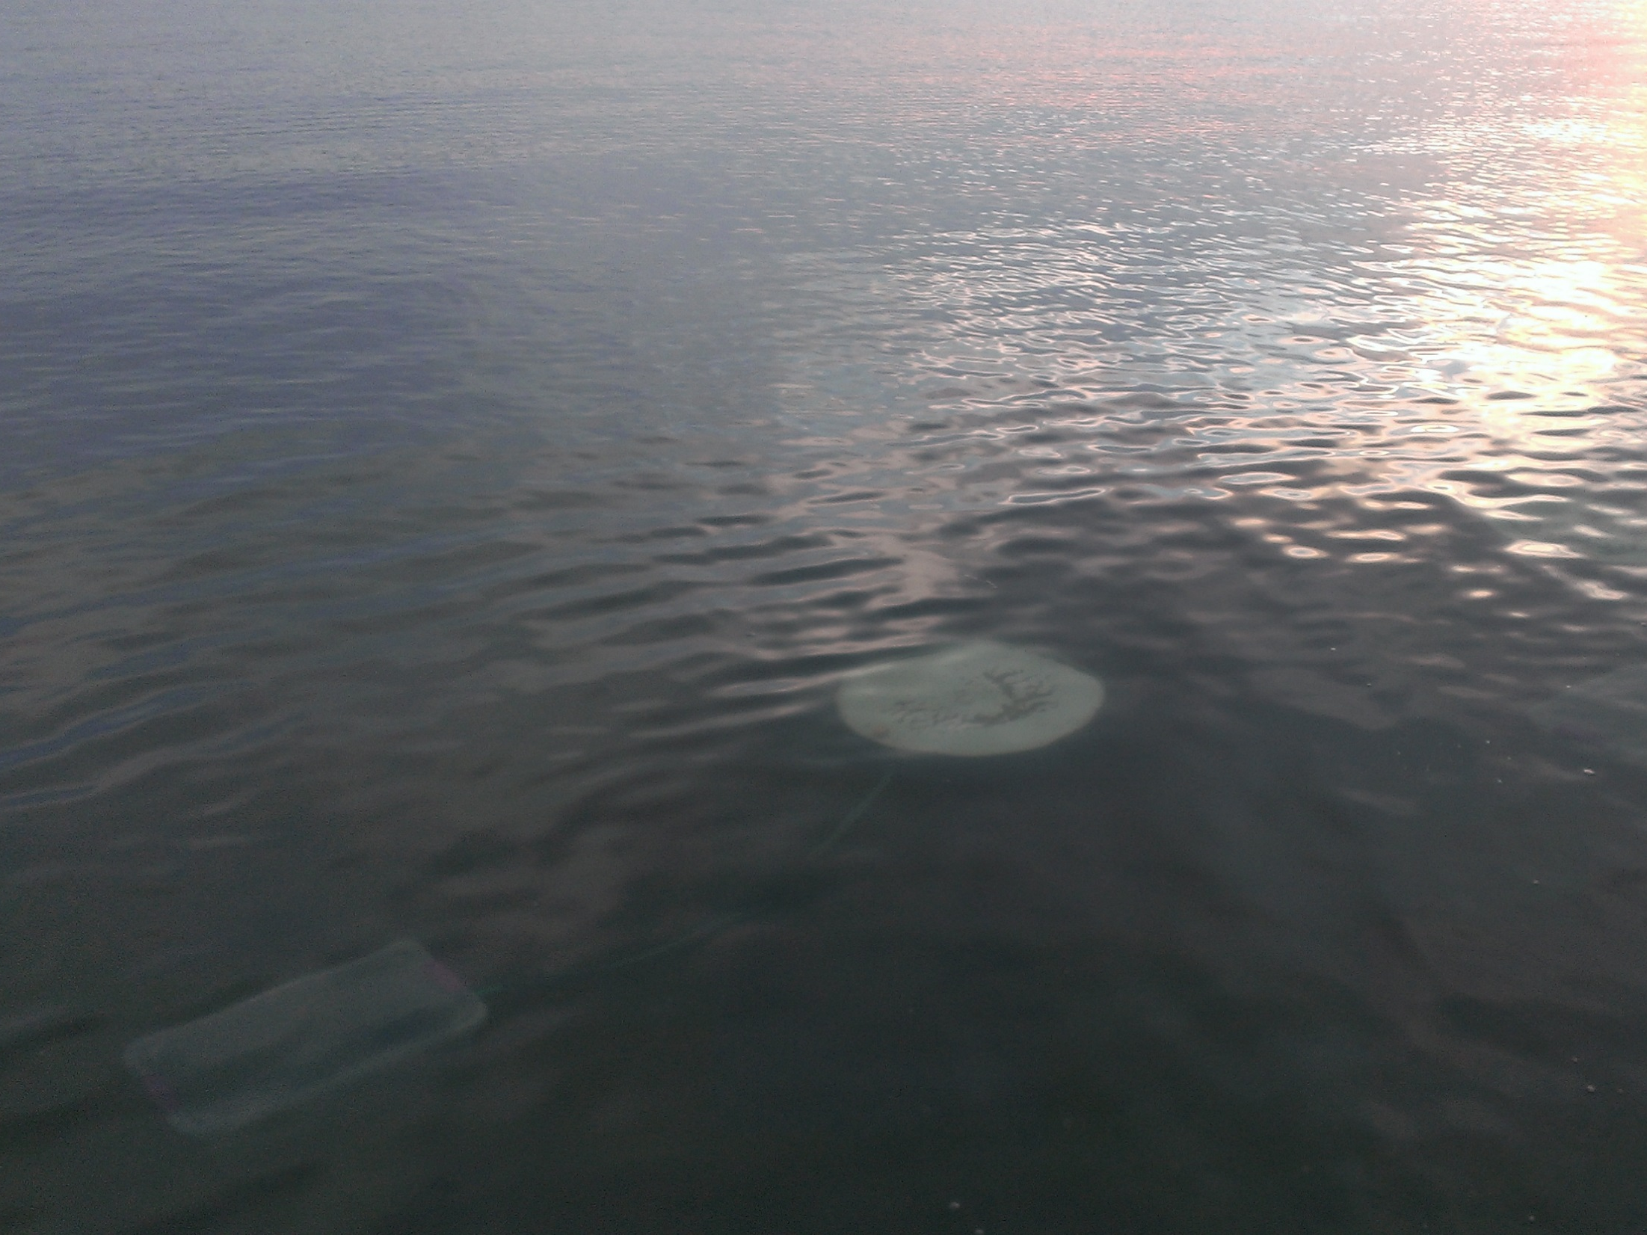
Statistical Analysis of Lake Levels - Objectives
Short-term (1999-2014) analysis
- Assess lake-level fluctuations across region
- Determine if climatic, landscape, or geologic
characteristics (40 variables) can explain
lake-level variations
Long-term (1925-2014) analysis
Evaluate temporal relations between
precipitation and lake levels
Notes:
The first part of the presentation will discuss the statistical analysis of lake levels. The analysis were done using two sets of data: short-term and long-term analysis.
The objective of the short-term analysis were ….
The objective of the long-term analysis was to

Slide 6
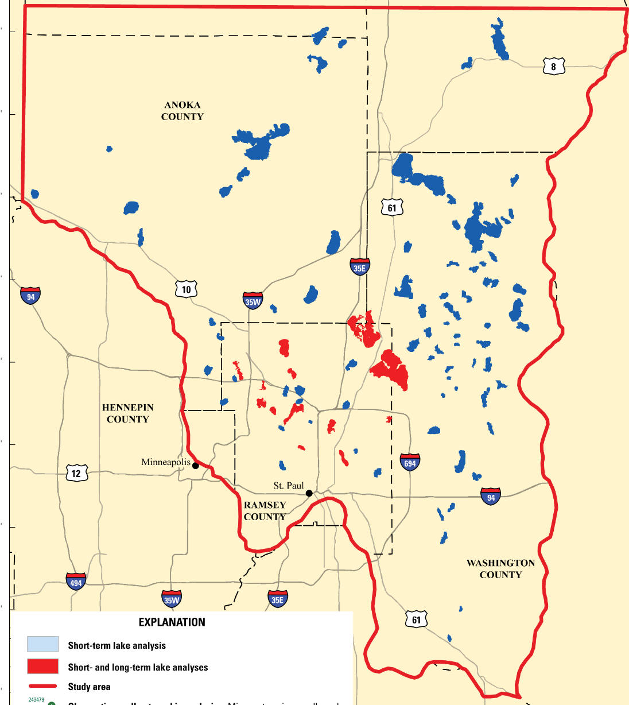
Statistical Lake-Level Analysis
Short-term
96 lakes
Long-term
14 lakes
Selected based on lake-level data
Short-term
Short and long-term
Study Area
Notes:
Why were these lakes selected?
Based on water-level measurements in at least 2 months for each year of the analysis during open-water season (April-November)

Slide 7
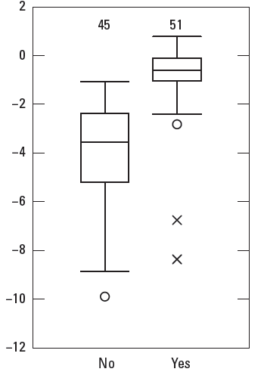
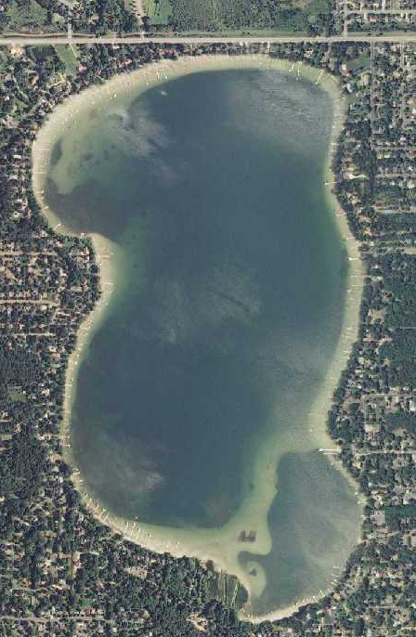
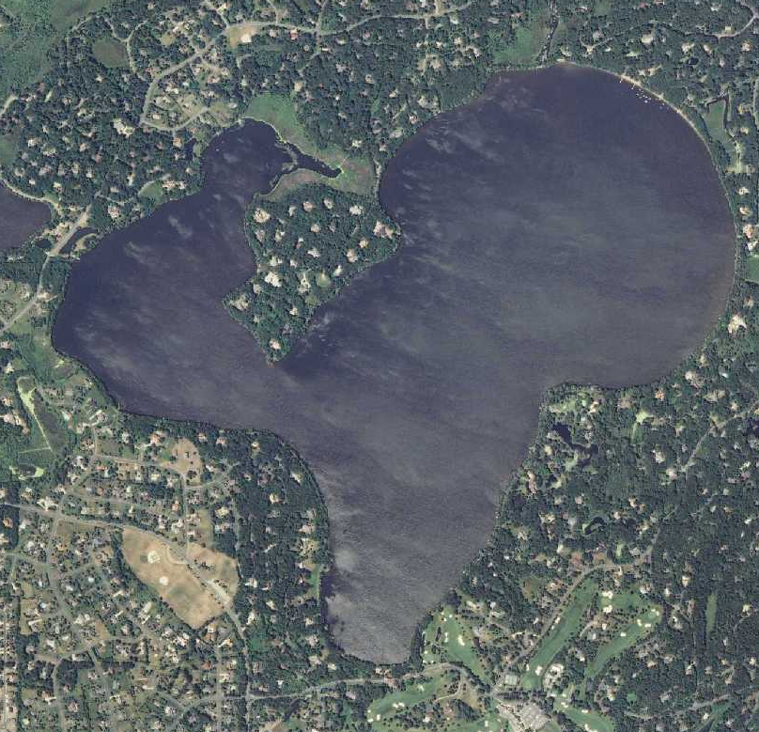

Lake-level variability – based on lake type
Closed-basin Lake
Flow-through Lake
active surface-water
outlet
no active surface-water outlet
Turtle Lake
Pleasant Lake
Outflow
Closed basin
Flow-through
Notes:
Main bullets for short-term analysis:
1. Lake levels were stable for lakes with large watersheds that supported consistent outflow.
2. Closed-basin lake levels changed more at high elevations compared low elevations. High elevation lakes were typically in rural settings on Superior Lobe deposits.
3. Lake levels were more stable in urban compared to rural settings. There was a higher frequency of flow-through lakes and outlet control structures in urban compared to rural settings.
4. Local variability in precipitation and evaporation was not correlated to lake-level changes across the northeast TCMA.
a note about data quality:
5. Contributing area for closed-basin lakes is not well-represented in the DNR watershed suite. The contributing areas are dynamic through time. As wetland area within watersheds increased, the lake level change increased, suggesting poor connectivity between lakes and their watersheds.

Slide 8
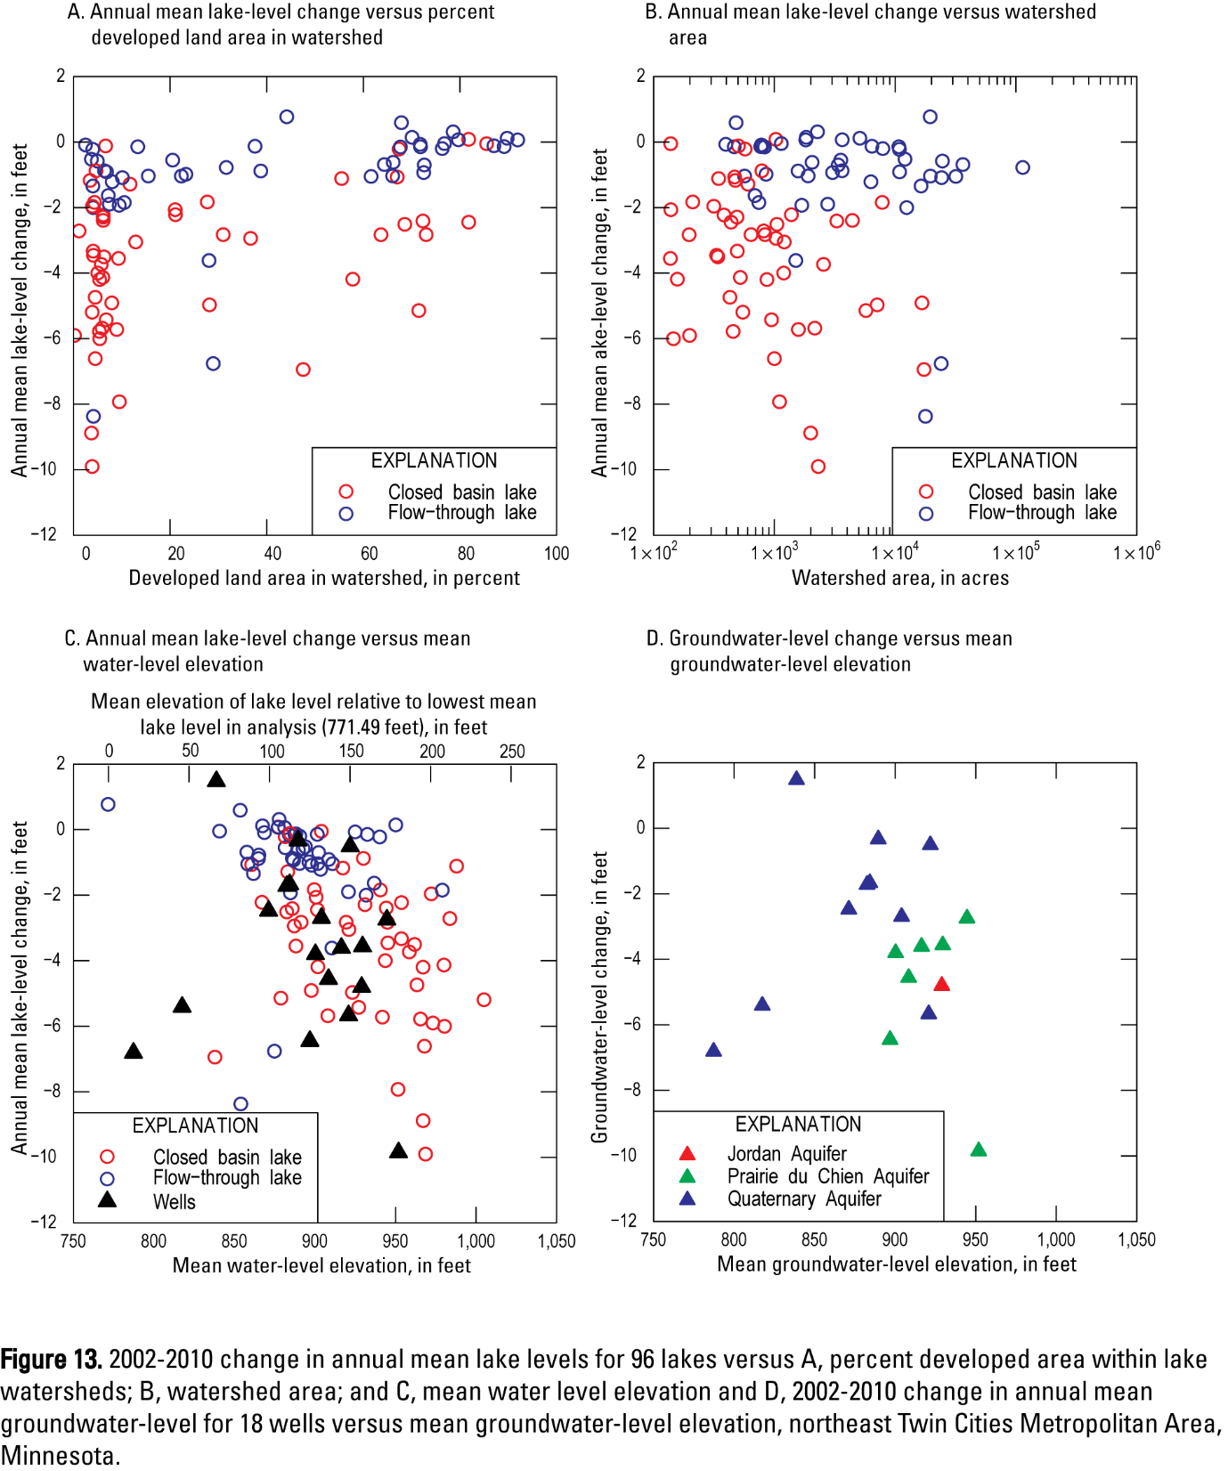
Lake levels more stable in urbanized areas
Rural
Urbanized
most urban lakes are flow-through
most rural lakes are closed-basin
Notes:
Point out that Horseshoe and Little Carnelian Lakes changed to closed-basin lakes during 2003-2013

Slide 9
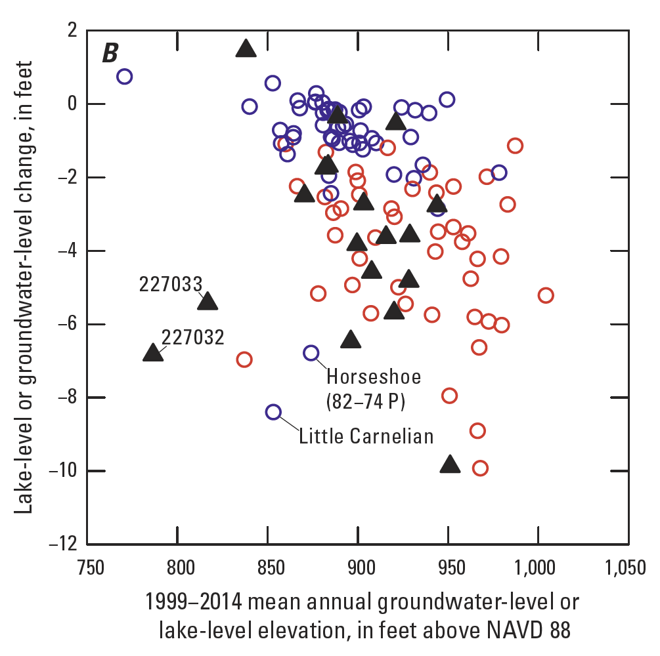
Closed-basin lake levels declined more at higher elevations similar to groundwater levels
Notes:
Short-term statistical analysis (2002-2010)
Water levels in flow-through lakes significantly less variable than in closed-basin lakes
Closed-basin lake-level changes reflected groundwater-level changes in the Quaternary, Prairie du Chien, and Jordan aquifers
Lakes that had outlet-control structures, such as culverts and weirs, had significantly smaller multi-year, lake-level changes
Closed-basin lakes and groundwater levels in the region extending from White Bear Lake northeast to Goose Lake had the greatest water level declines during 2002 to 2010.

Slide 10
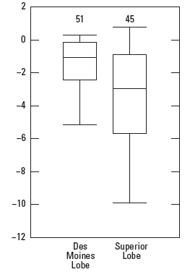

Geologic Characteristics vs. Lake-level Change (2002-2010)
Primary Geologic Unit
Buried Bedrock Valley Under Lake
No
Yes
Des Moines Lobe
Superior Lobe

Slide 11
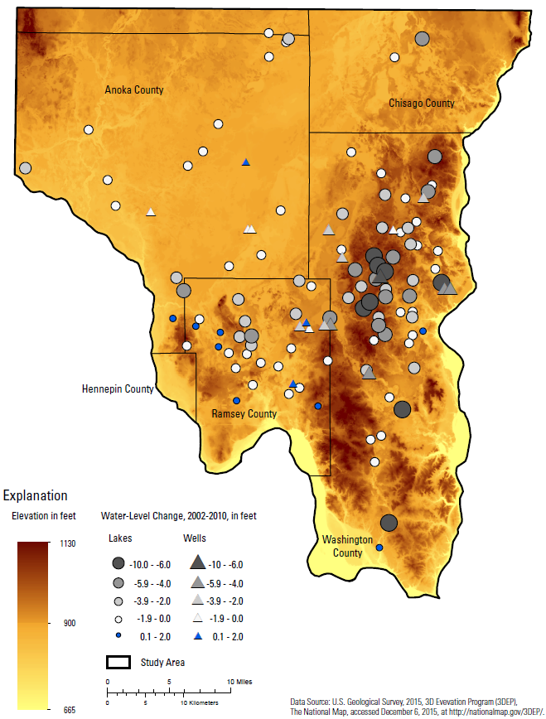
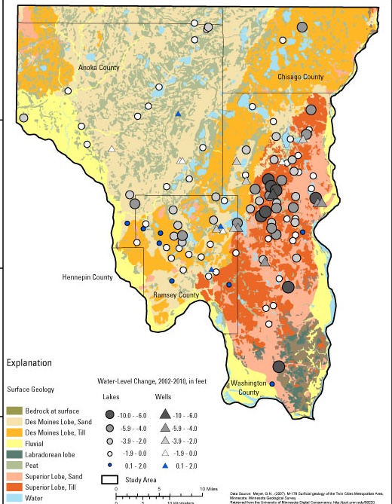
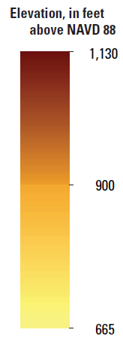
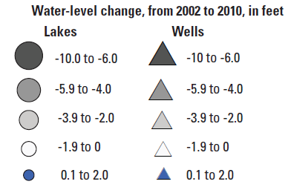
Closed- basin lakes – water levels more variable at high elevations, in Superior Lobe deposits
Des Moines Lobe Deposits
Superior Lobe Deposits

Slide 12
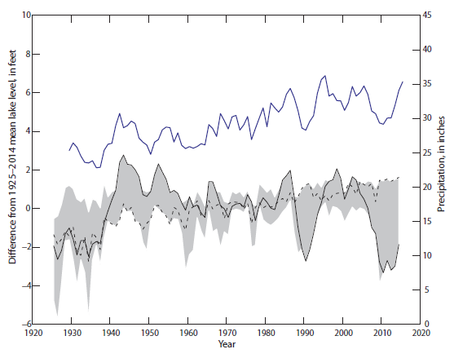
Long-term analysis (1925-2014)
White Bear Lake – most variable level
Range in annual lake- level anomalies- 14 lakes
White Bear Lake
Valentine Lake
Precip, 5-yr moving average
Annual lake-level anomaly =
mean annual lake level – long-term mean
Notes:
Describe the graph

Slide 13
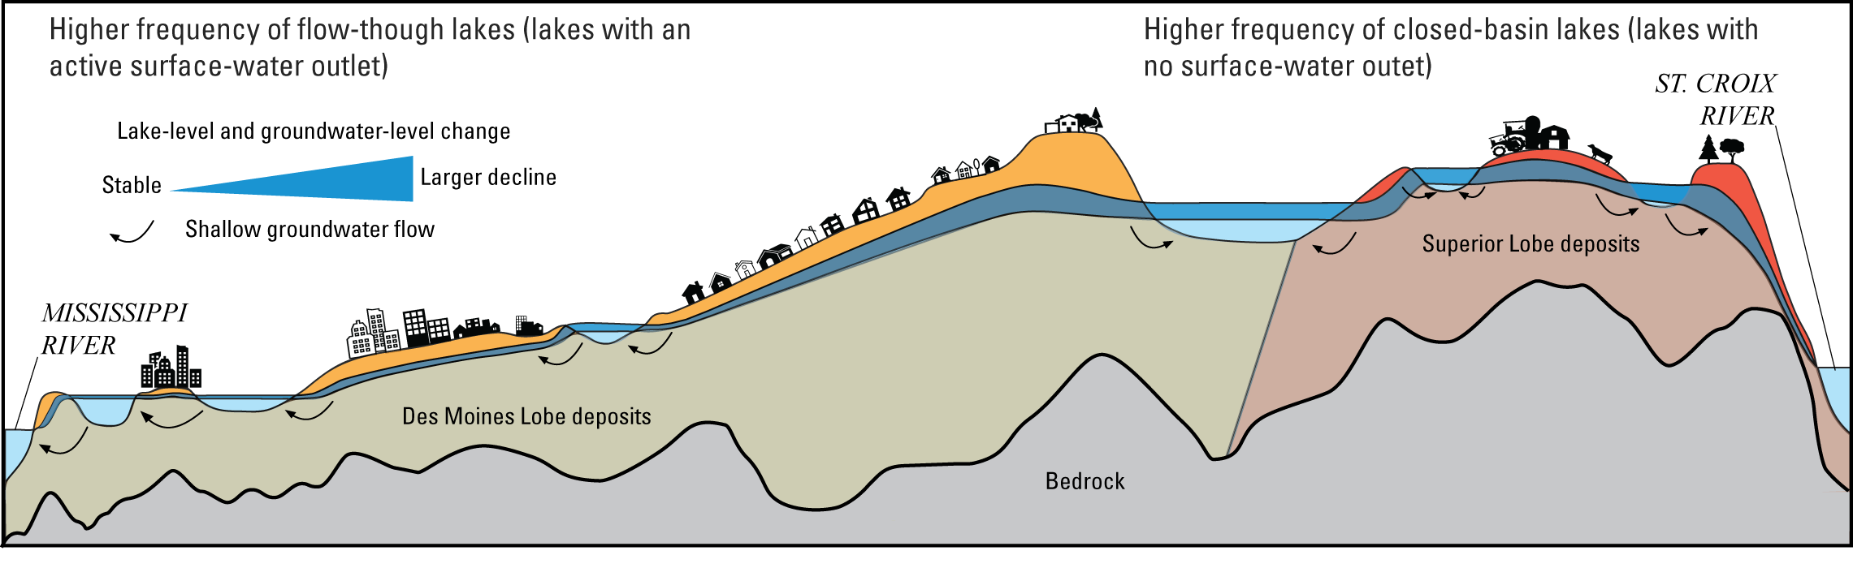
Statistical Analyses of Lake Levels - Results
Lake type (flow-through/closed-basin), elevation, development, and glacial geology were variables affecting lake-level variability
Notes:
Main bullets for short-term analysis:
1. Lake levels were stable for lakes with large watersheds that supported consistent outflow.
2. Closed-basin lake levels changed more at high elevations compared low elevations. High elevation lakes were typically in rural settings on Superior Lobe deposits.
3. Lake levels were more stable in urban compared to rural settings. There was a higher frequency of flow-through lakes and outlet control structures in urban compared to rural settings.
4. Local variability in precipitation and evaporation was not correlated to lake-level changes across the northeast TCMA.
a note about data quality:
5. Contributing area for closed-basin lakes is not well-represented in the DNR watershed suite. The contributing areas are dynamic through time. As wetland area within watersheds increased, the lake level change increased, suggesting poor connectivity between lakes and their watersheds.

Slide 14
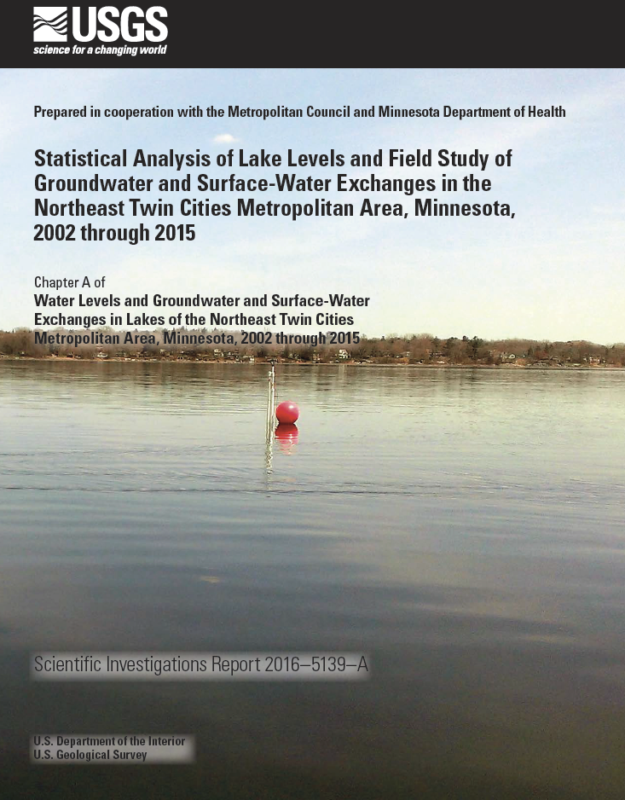
USGS Reports
Available online
http://dx.doi.org/10.3133/sir20165139

Slide 15
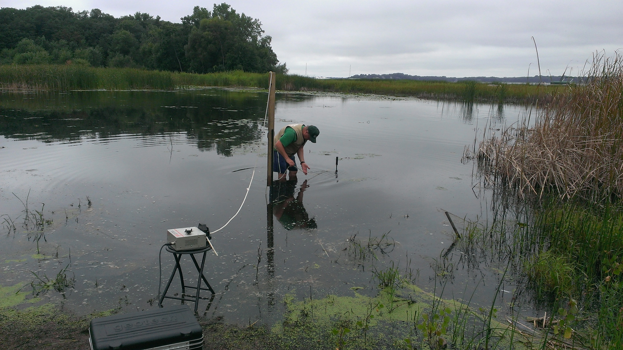
Questions?

