Slide 1
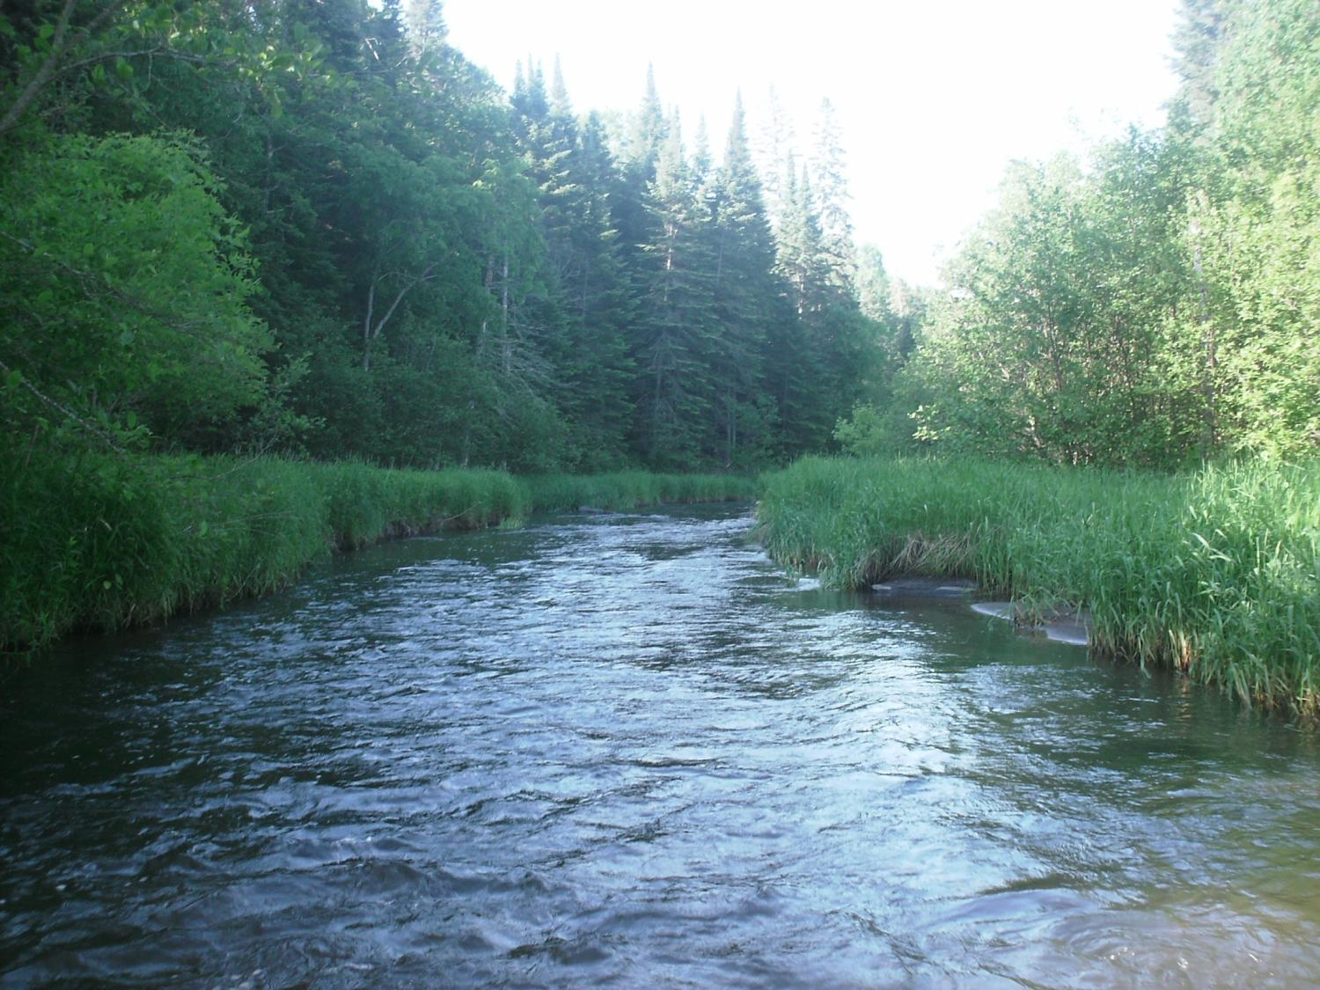
Legislative Water Commission
August 21, 2018
Co-chairs: Senator Wiger Representative Torkelson
Jim Stark, Director
Straight River, Becker County
1

Slide 2
Legislative Water Commission
Thursday ,August 21, 2018 (10 am)
State Office Building: Room 10
Rep. Paul Torkelson, Chair Sen. Chuck Wiger, Co-Chair*
* Presiding
Agenda
Approval of minutes– July 2018
Water Issues Presentations: Minnesota Groundwater Association White Paper on Drainage and Groundwater--Kristen Blann ( TNC)
2019 LWC Recommendations and Process-Jim Stark
Review of Clean Water Fund Meeting - Jim Stark
Future meeting discussion
Adjourn
2

Slide 3
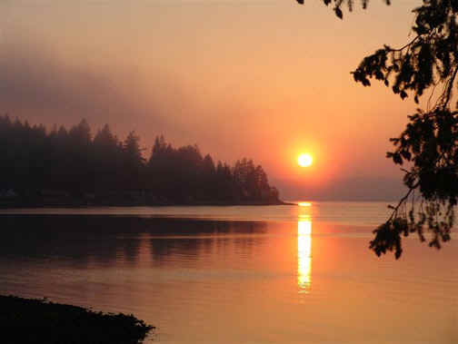
Water Issue Presentations
Drainage and Groundwater MGWA White Paper
Kristen Blann (TNC) / Ellen Considine (DNR)
Notes:
For more information and real time monitoring data you can visit this web site.

Slide 4
2019 Legislative Stakeholder Issue and Recommendation Process
Notes:
For more information and real time monitoring data you can visit this web site.

Slide 5
2019 Recommendation Process
Six Issues/Five Stakeholder meetings At each meeting:
Discuss Issues and recommendations, based on:
LWC guidance
Stakeholder advice
Review of plans/documents

Slide 6
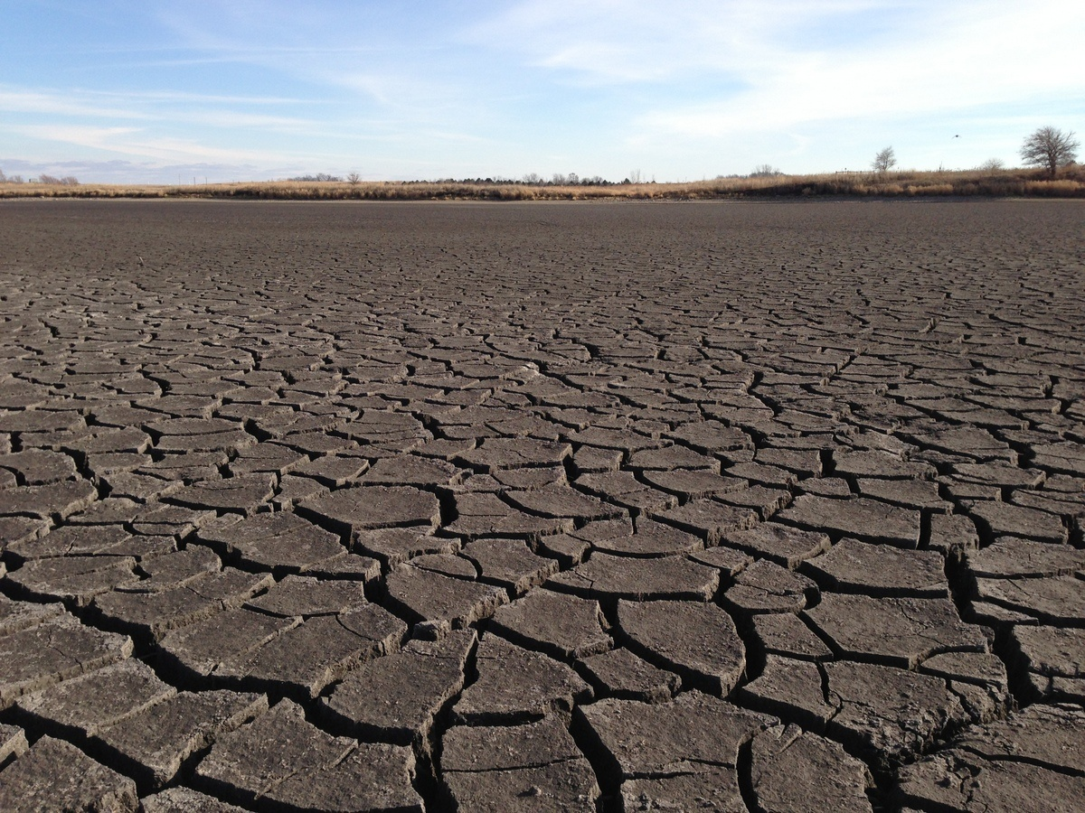
A Firm Foundation
1989- GW Act
1999- USGS Sustainability Report
2004- G16 Impaired Waters Plan (MPCA)
2005- DNR/GW Report
2006- Clean Water Legacy Act
2006- ENRTF Sustainability Report
2008- Clean Water Amendment
2008 Legislative Water Sustainability Framework
2009- EQB Sustainability Report
2012- GW Management Area Plans (DNR)
2017- Freshwater Society Reports on Water Sustainability
(Worthington, MN-2012)

Slide 7
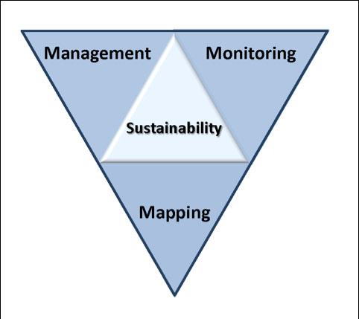
Six issues/Five Stakeholder Meetings
Topical areas
Wastewater*
Drinking water*
Groundwater
Sustainable Lakes
Water retention
Future state
* Short term
Notes:
Protection of ground water and surface water resources will require substantial investments from a diversity of funding sources over all levels of government during the next decade. As a part of this effort, this program of mapping, monitoring and managing is necessary to deliver the basic understanding of the hydrologic system for both surface and groundwater.

Slide 8
How can the recommendations be used?
Propose/promote/support legislation
Resource for stakeholders- legislative initiatives
Recommendations to guide or suggests programs/planning/funding:
LCCMR
Lessard-Sams Outdoor Heritage Council
CWC
Agencies/Governor’s Office

Slide 9
Issue of the Day
9

Slide 10
Resources:
Recommendation/issue summary paper-draft
Background issue paper- draft
Notes:
For more information and real time monitoring data you can visit this web site.

Slide 11
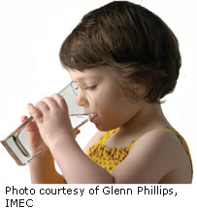
Drinking Water
Many Issues:
Significant infrastructure needs– small cities and towns
Source-water protection: SW/GW
Private Drinking Water Threats: nitrate, pesticides, chloride, lead, arsenic, radon, bacteria, viruses, pharmaceuticals, human-produced chemicals, emerging contaminants, toxic algae, spills
Non-sustainable use
Notes:
What we hope to leave you with is a much better understanding of our state’s groundwater resources and appreciation for the challenges we face.
Simply stated the problem we are increasingly recognizing is that there are ….

Slide 12
Small Group Exercise
Discuss recommendations
What’s missing?
Who’s missing?
Rank (H,M,L)
Are they actionable- Move the needle?
Appropriate for Legislation/ Funding/Agency or Stakeholder Resource?
Consensus
Report back:
Top issues (1-2) and missing issue
40 minutes
Notes:
For more information and real time monitoring data you can visit this web site.

Slide 13
Next Steps
Revise Issue Statements
Revise Recommendations
Initial Consensus from LWC
Feedback from Stakeholders
Final consensus by LWC -November
Recommendations to Legislature
Legislative Briefings with Committees?

Slide 14
Recommendation Progress
Progress:
Three meetings
Four issues covered
Good attendance and comments
Plans:
Complete meetings-August
LWC- Discussion and feedback-September
Feedback from stakeholders- 2 meetings
LWC: Second review and consensus-October
Discussions: Environmental Committees/Commissions
Legislative path Forward- November

Slide 15
Groundwater and Drinking Water
Stakeholder Recommendations
15

Slide 16
Recommendations: Groundwater Sustainability- Ranked
Recharge and re-use
Data, Information and Analysis
Protect vulnerable aquifers
Water Bank Accounts
Analysis and Modeling
GW/Surface Water Interactions
Enhance Water Appropriation Process
Economic Analyses of GW
Connections between Hydrology and Aquatic Biology
Economic Importance of Sustainable Water
Legislation: Propose legislation to limit overuse of chloride
Consolidate GW regulations among agencies
Inter-jurisdictional water planning
Establish a Clean Water Council Sustainability Committee
Legislation: over-use of nitrate fertilizer

Slide 17
Recommendations: Drinking Water-- Ranked
Improve monitoring/ information/education/mitigation of contaminants
Increase investment in drinking water infrastructure
Increase support for source-water protection
Increase the MDH drinking water connection fee
Monitoring to detect potential threats to water supplies
Assess/invest in water asset management plans
Implement the groundwater protection rule
Embrace new technology for drinking
Identify location/condition of failing septic systems
Legislation: failing homes and businesses wastewater systems.
Legislation: return provision for pharmaceuticals
Funds to assess viruses
Legislation: surface water/source water protection
Suggested: Adopt risk-based management of drinking water threats
Suggested: Revise statutes/improve agency management of water

Slide 18
Clean Water Council Update: Jim Stark
18

Slide 19
2018 Meeting Schedule
Stakeholder meetings: July 18 (drinking water, groundwater); July 25 (wastewater, storm water); Aug. 8 (water retention); Aug 22 (lakes) and; August 29 (future state for MN waters). All at 1:00 pm (SOB)
August 20—LWC meeting and field tour—rural water management (9:00 am, site TBD) Yes?
Future LWC meetings: Discuss meeting times
Sept 17
October 15
November 13
December 10* (* Date change at Co-chair’s request)

Slide 20
Thanks!
Notes:
For more information and real time monitoring data you can visit this web site.

