Slide 1
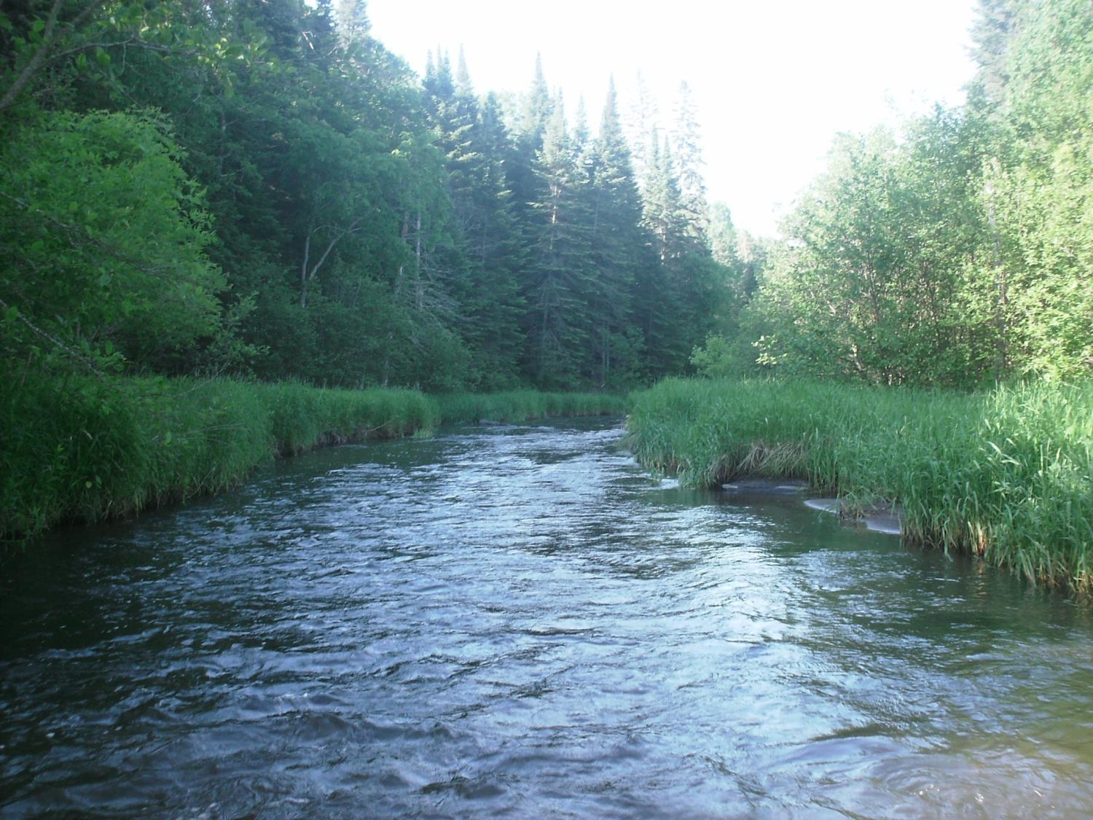
Legislative Water Commission
2019 Recommendation Feedback
Preserving and Protecting our Lakes
Co-chairs: Senator Wiger Representative Torkelson
Jim Stark, Director
Straight River, Becker County
1

Slide 2
Introductions
LWC members
Legislators
Kasey Gerkovich
Jim Stark
2

Slide 3
Legislative Water Commission
REVIEW-state agencies’ water policy reports & recommendations
GATHER- data and comments
LEGISLATIVE RECOMMENDATIONS: Assist legislature in formulating legislation
SHARE-data & information with LCCMR, CWC, legislative standing committees, upon request
COORDINATE-with the CWC

Slide 4
How can the recommendations be used?
Propose/promote/support legislation
Resource for stakeholders regarding legislative initiatives
Recommendations to guide or suggests programs/planning/funding:
LCCMR
CWC
Agencies

Slide 5
LWC: 12 Members
Body | First Name | Last Name | Party | District | Home
Sen | Paul | Anderson | R | 44 | Plymouth
Rep | David | Bly | DFL | 20B | Northfield
Sen | Rich | Draheim | R |  | Madison Lake
Sen | Kent | Eken | DFL | 4 | Twin Valley
Rep | Peter | Fischer | DFL | 43A | Maplewood
Rep | Glenn | Gruenhagen | R | 18B | Glencoe
Sen | Jason | Isaacson | DFL | 19A | Shoreview
Rep | Clark | Johnson | DFL | 19A | N. Mankato
Rep | John | Poston | R | 9A | Lake Shore
Rep | Paul | Torkelson* | R | 16B | Hanska
Sen | Bill | Weber | R | 22 | Luverne
Sen | Chuck | Wiger* | DFL | 43 | Maplewood

Slide 6
Agenda
2018 Process
2019 Process
Overview of possible 2019 Issues
Describe Today’s Issue
Small Group Review/Report
Next Steps

Slide 7
2019 Recommendations
Six Issues with recommendations:
Based on:
2018 session process
LWC guidance
Stakeholder advice
Review of many plans/documents

Slide 8
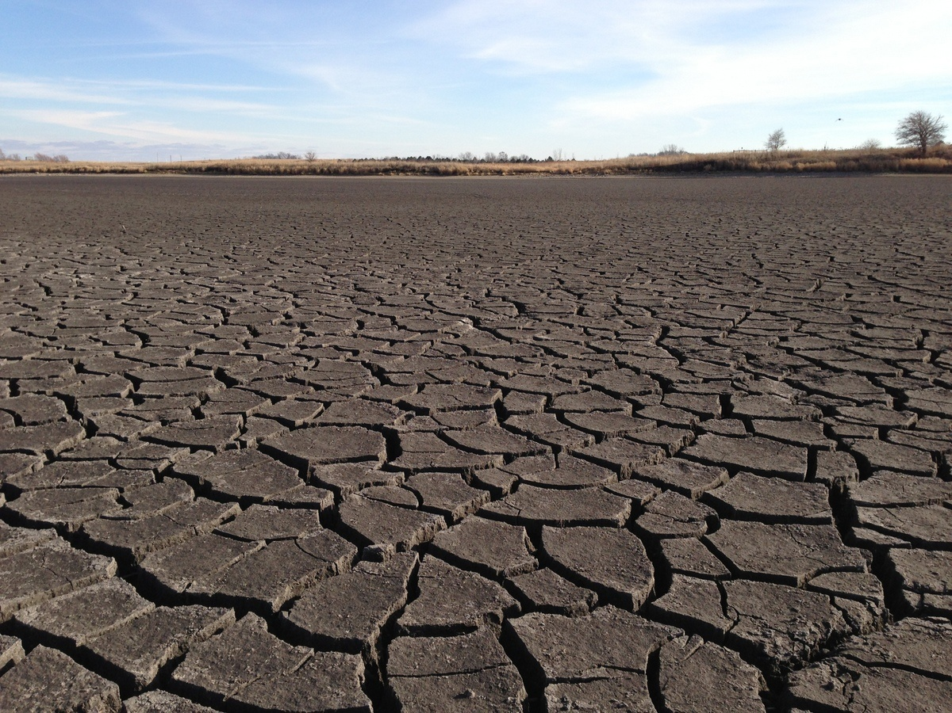
A Firm Foundation
1989- GW Act
1999- USGS Sustainability Report
2004- G16 Impaired Waters Plan (MPCA)
2005- DNR/GW Report
2006- Clean Water Legacy Act
2006- ENRTF Sustainability Report
2008- Clean Water Amendment
2008 Legislative Water Sustainability Framework
2009- EQB Sustainability Report
2012- GW Management Area Plans (DNR)
2017- Freshwater Society Reports on Water Sustainability
(Worthington, MN-2012)

Slide 9
Six Issue Areas
9

Slide 10
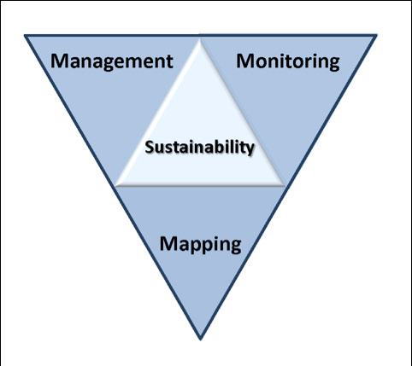
2019 LWC Issues and Recommendations
Wastewater*
Drinking water*
Groundwater
Sustainable Lakes
Water retention
Future state
* Short term
Notes:
Protection of ground water and surface water resources will require substantial investments from a diversity of funding sources over all levels of government during the next decade. As a part of this effort, this program of mapping, monitoring and managing is necessary to deliver the basic understanding of the hydrologic system for both surface and groundwater.

Slide 11
Today’s Issue
11

Slide 12
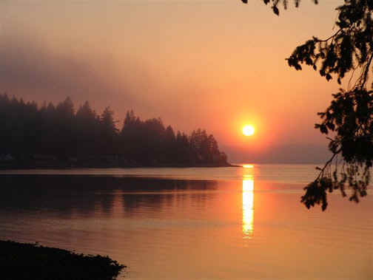
Lakes- What are the Issues?
Our lakes are important!
Many economic benefits
Healthy lakes enhance our lives
Support food-web interactions
Contribute to a healthy economy
Important for tourism
Recreation
Notes:
For more information and real time monitoring data you can visit this web site.

Slide 13
Lakes- What are the issues? (2)
Our activities affect our lakes:
Lakes are short-lived features
Natural aging is being accelerated
We need to protect and restore our lakes.
Vast number of lakes and many threats
We may need to make decisions about which lakes to protect and preserve.
Notes:
For more information and real time monitoring data you can visit this web site.

Slide 14
Lakes- What are the issues? (3)
Things can be done:
Improve best-management practices
For lakes with water-level changes--increase GWMA program
More proactive and aggressive approach for our most important lakes
Create a protected status for some lakes
Enhance conservation easements in the watersheds where these lakes exist.
Notes:
For more information and real time monitoring data you can visit this web site.

Slide 15
Recommendations: Lakes
Legislation- Enable lake management districts
Legislation-Limited liability for de-icing applicators
Legislation: Stop invasive species migration
Legislation: Emerging contaminants- pharmaceutical take-back
Assess watershed best-management practices as they apply to lakes.
Increase Groundwater Management Area Program
Enhance funds for conservation land easements
Provide funding for a sentinel lakes program
Establish a status of lakes consensus document
Water budget information for lake planning- 1 Watershed/1Plan
Policy/legislation/incentives aimed at protecting shorelines of lakes
Deep Lakes: Provide additional agency support to understand stressors and best management practices.

Slide 16
Recommendations: Lakes-2
Program support to assess lakes for climate change adaptation
Provide additional agency support -- shallow lakes.
Studies to better assess impact of groundwater on lakes
Program to assess/fix leaking septic systems
Economic analyses of ROI for lakes
Groundwater recharge: Identify and protect recharge areas
Maintain and enhance information and monitoring programs for lakes
Understand the importance of landscape settings for lakes
Legislation—Inter-jurisdictional water planning
Increase understanding of interrelations of hydrology/water quality/ aquatic biology in our lakes
Dedicate portion of Clean Water funds for lake sustainably efforts.

Slide 17
Today’s Request:
Small groups
Review issues/recommendations
Missing issues?
Missing stakeholders?
Rank issues (H/L)
Seeking your input--not consensus
Will revisit issues later
17

Slide 18
Resources:
Recommendations
Background issue paper- draft
Notes:
For more information and real time monitoring data you can visit this web site.

Slide 19
Small Group Exercise
Discuss recommendations
What’s missing?
Who’s missing?
Rank (H,L)
Are they actionable- Move the needle?
Appropriate for Legislation/ Funding/Agency or Stakeholder Resource?
Consensus
Report back:
Top issues (1-2) and missing issue
40 minutes
Notes:
For more information and real time monitoring data you can visit this web site.

Slide 20
Outcome for today: an example –drinking water
Improve monitoring/ information/education/mitigation of contaminants Increase investment in drinking water infrastructure
Increase support for source-water protection
Increase the MDH drinking water hook-up fee.
Monitoring to detect potential threats to water supplies
Assess/invest in water asset management plans
Implement the groundwater protection rule
Embrace new technology for drinking
Identify location/condition of failing septic systems
Legislation: failing homes and businesses wastewater systems.
Legislation: return provision for pharmaceuticals
Funds to assess viruses
Legislation: surface water/source water protection
Suggested: Adopt risk-based management of drinking water threats
Suggested: Revise statutes/improve agency management of water

Slide 21
Next Steps
Complete Issue papers
Revise recommendations based on your input
Feedback from LWC Members
Additional Feedback from Stakeholders
Final consensus by LWC
Recommendations to Legislature- before session
Legislative Briefings with Committees

Slide 22
Small Group Exercise
Discuss recommendations
What’s missing?
Who’s missing?
Rank (H,M,L)
Are they actionable- Move the needle?
Appropriate for Legislation/ Funding/Agency or Stakeholder Resource?
Report back:
Top issue and most important missing issue
40 minutes
Notes:
For more information and real time monitoring data you can visit this web site.

Slide 23
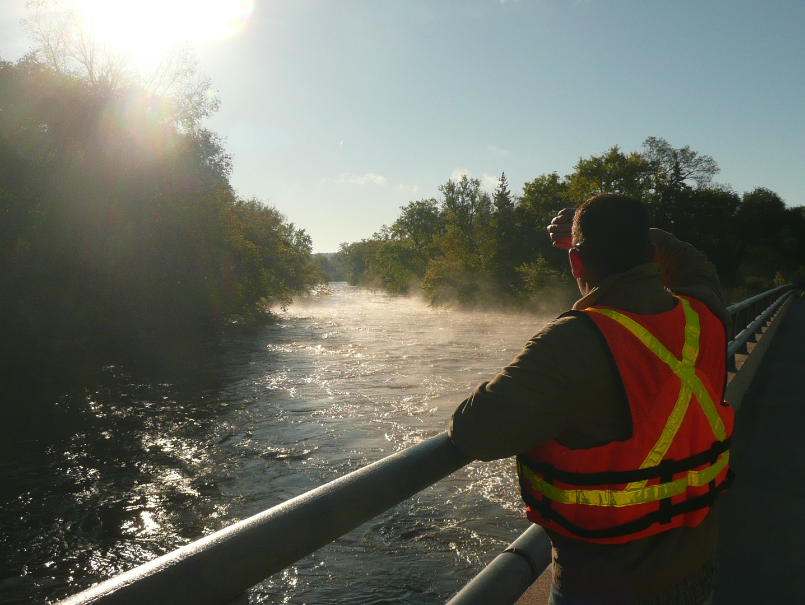
Thank You

Slide 24
Next Steps
Please turn in your spreadsheet (1 per group)
Revise Issue Statements
Revise Recommendations
Initial Consensus from LWC
Feedback from Stakeholders
Final consensus by LWC -November
Recommendations to Legislature
Legislative Briefings with Committee

Slide 25
Thanks!
Notes:
For more information and real time monitoring data you can visit this web site.

