Slide 1
Federal Water Rules – WOTUS & 401
Melissa Kuskie| Manager – Certifications, Environmental Review & Rules
November 12, 2019

Slide 2
Waters of the U.S. (WOTUS)
The Clean Water Act (CWA) does not define WOTUS – it has been interpreted via federal agency guidance/regulations and court decisions over several decades.
2015 – EPA finalized the Clean Water Rule: Definition of WOTUS
2017 – EPA announces a two-step approach to revising WOTUS definition
  Repeal of 2015 Clean Water Rule
  Revised regulatory definition of WOTUS
Notes:
Evolution of the term - the jist of it is that it started very narrow – very focused on navigable and interstate waters, and expanded in the late 70s/early 80s to address many waters. Court decisions started to narrow jurisdiction in late 90s (previously, there was an expansive interpretation of the Commerce Clause, such that waters that could affect interstate commerce, for example, by serving as habitat for migratory birds, could be federally regulated; the U.S. v Lopez court decision – which had nothing at all to do with waters and instead focused on gun free zones near schools – narrowed interpretation of the Commerce Clause of the Constitution, and eventually found its way to WOTUS).
First started to affect isolated (non-adjacent) wetlands, eventually created confusion on adjacency. Here, the Rapanos Supreme Court decision added considerable confusion – four-justice plurality opinion by Scalia focusing on waters with continuous surface connection to permanent standing/flowing bodies of water versus Justice Kennedy’s separate (solo) concurring opinion focusing on “significant nexus” to waters that are “navigable in fact.” Significant nexus significantly impacting the chemical, physical and biological integrity of a traditionally navigable waterbody. This created, unsurprisingly, great confusion.
2015 – Obama’s EPA WOTUS definition – attempted to clarify/regulate via the “significant nexus” test. ID’d waters that are “categorically” jurisdictional (the permanent/navigable waters and those with continuous surface connection to them), waters that may be deemed WOTUS on case by case basis upon finding of “significant nexus” which may include intermittent and ephemeral streams and wetlands; and waters that are NOT WOTUS – prior converted cropland, groundwater, certain ditches, etc. Rule was struck down or stayed in some states (both district and appellate courts)
2017 – Trump’s EPA – unsurprisingly, intended to revise prior regulatory definition and be more consistent with Scalia’s opinion. Two steps – repeal the 2015 rule, then promulgate new defitions

Slide 3
WOTUS – so where are we now?
Repeal of 2015 Clean Water Rule published in Federal Register October 22, 2019 – effective December 23, 2019
  Recodifies prior regulatory definitions that existed prior to 2015 rule
Revised regulatory definition of WOTUS proposed December 2018 (proposal published February 14, 2019). Agency reviewing comments now.
  Moves from the “significant nexus” of the Clean Water Rule to more specific considerations of adjacency
Notes:
(a) The term waters of the United States means (1) All waters which are currently used, or were used in the past, or may be susceptible to use in interstate or foreign commerce, including all waters which are subject to the ebb and flow of the tide; (2) All interstate waters including interstate wetlands; (3) All other waters such as intrastate lakes, rivers, streams (including intermittent streams), mudflats, sandflats, wetlands, sloughs, prairie potholes, wet meadows, playa lakes, or natural ponds, the use, degradation or destruction of which could affect interstate or foreign commerce including any such waters: (i) Which are or could be used by interstate or foreign travelers for recreational or other purposes; or (ii) From which fish or shellfish are or could be taken and sold in interstate or foreign commerce; or (iii) Which are used or could be used for industrial purpose by industries in interstate commerce; (4) All impoundments of waters otherwise defined as waters of the United States under the definition; (5) Tributaries of waters identified in paragraphs (a)(1) through (4) of this section; (6) The territorial seas; (7) Wetlands adjacent to waters (other than waters that are themselves wetlands) identified in paragraphs (a)(1) through (6) of this section
(c) The term adjacent means bordering, contiguous, or neighboring. Wetlands separated from other waters of the United States by man-made dikes or barriers, natural river berms, beach dunes and the like are ‘‘adjacent wetlands.’’
The repeal isn’t necessarily going to feel terribly different for the time being – 2015 rule was challenged in court immediately and was stayed/vacated in many states.
Proposed rule - certainly includes navigable waters and tributaries; focuses again on wetlands ADJACENT to other jurisdictional waters. Ephemeral streams are excluded, “intermittent” streams have more “typical year” flow expectations prescribed. One of the concerns we ID’d was in terms of typical flow – whether/how variability in precip/flow factors in climate change impacts. Also sought clarity on mapping – which waters will see a change in jurisdiction? EPA didn’t really have a clear sense of that with respect to a lot of headwaters in particular.

Slide 4
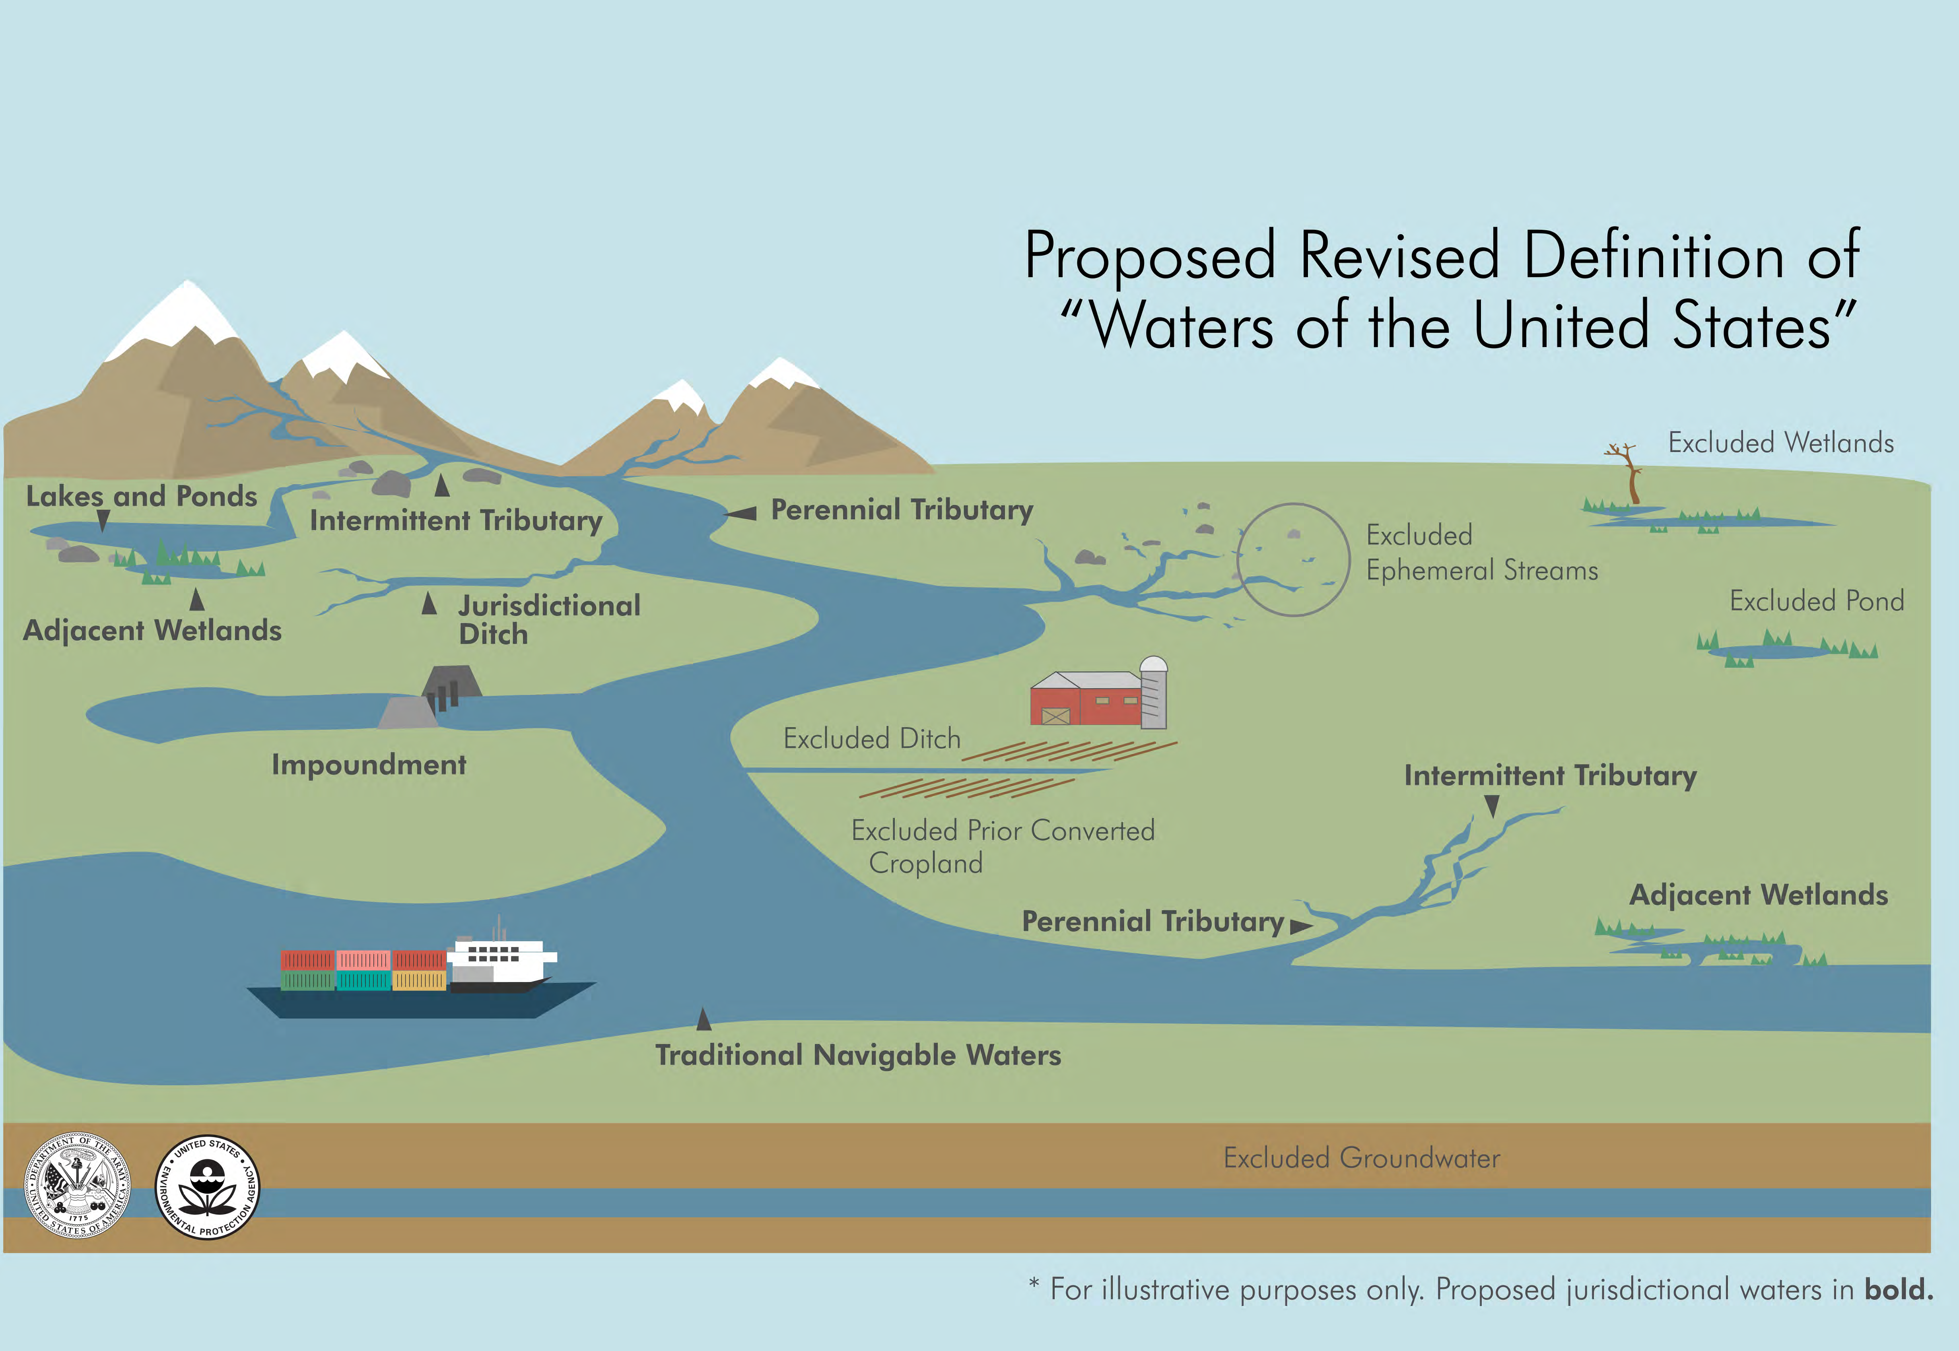
WOTUS – proposed jurisdictions
Notes:
In general, unsurprisingly, the proposed rule would limit the jurisdictional definition of WOTUS. Certainly includes navigable waters and tributaries; focuses again on wetlands ADJACENT to other jurisdictional waters. Ephemeral streams are excluded, “intermittent” streams have more “typical year” flow expectations prescribed.

Slide 5
WOTUS – comparison of regulatory jurisdictions
Rule Topic | Older Regulations (Pre-2015) | Clean Water Rule (2015) | Proposed Rule: Revised Definition
Adjacent Wetlands/Waters | Adjacent wetlands jurisdictional. “Adjacent” defined as bordering, contiguous, or neighboring; wetlands behind berms, dikes, and the like are adjacent. | Adjacent waters are jurisdictional. Definition of “adjacent” retained, including waters bordering or contiguous or behind berms being adjacent. Defines “neighboring” for first time as including waters within 100 feet of a traditional navigable water, interstate water, territorial seas, impoundment of jurisdictional waters, or tributary, or within 100-year floodplain to a maximum of 1,500 feet of the ordinary high water mark, or within 1,500 feet of the high tide line. Entire water is “adjacent” if all or part bordering, contiguous, or “neighboring.” Waters part of an ongoing farming, ranching, or silvicultural operation are not “adjacent,” but may be jurisdictional based on a case-specific analysis. | Adjacent now defined to mean wetlands that abut or have direct hydrological surface connection (intermittent or perennial flow included, ephemeral not included) to a WOTUS in a typical year. Adjacent wetlands jurisdictional if adjacent to 1)TNWs, 2) jurisdictional ditches, 3) jurisdictional lakes and ponds, 4) impounds of otherwise jurisdictional waters.
Notes:
Handout – This text is pulled from a table prepared by the Association of Clean Water Agencies – a multi-state organization. I have brought handouts of the full version of this table (which shows a number of categories of waters).

Slide 6
WOTUS vs Waters of the State – How does this affect MN?
Minn Stat. 115.01, subd 22 – “all streams, lakes, ponds, marshes, watercourses, waterways, wells, springs, reservoirs, aquifers, irrigation systems, drainage systems, and all other bodies or accumulations of water, surface or underground, natural or artificial, public or private, which are contained within, flow through, or border upon the state or any portion thereof.”
MN has broad jurisdiction, addressed through multiple regulatory programs
Notes:
Up until a few months ago, MN was interested, but not overly affected by the changes. MN has broad jurisdictional authorities – we not only define “waters of the state” very broadly, but we have multiple regulatory programs that address state waters (e.g., WCA, Work in Public Waters permits, NPDES permitting, and the 401 water quality certification). Even if the federal definition resulted in a shrinkage of waters that could be regulated federally, our patchwork of regulatory programs ensured that we could address water and water quality as the state determined necessary.

Slide 7
401 Water Quality Certification
On August 9, EPA released their proposed rule to update/significantly modify the 401 Water Quality Certification Regulations
EPA’s proposal seeks to:
  Shrink the scope of the 401 review
  Limit the authority of States and Tribes to review and condition federally permitted projects to protect their own water quality
    Gives federal agencies power to veto/nullify state decisions and conditions with no appeal process
    Gives federal agencies sole authority to determine the time states have to complete their review

Slide 8
WOTUS & 401 Certification in Minnesota
WOTUS changes will be more meaningful in Minnesota if EPA finalizes its 401 rule as proposed
State 401 Certifications would be limited to federal jurisdiction (i.e., WOTUS), rather than the state jurisdiction applicable over the past several decades

Slide 9
Now what?
MPCA submitted comments to EPA on the 401 proposal on October 21
  Expect final 401 rule in Spring 2020
MPCA/DNR jointly submitted comments on the WOTUS proposal
  No clear timeframe – expect final WOTUS rule in next several months
For now, MPCA will continue to implement 401 program under current state and federal law

Slide 10
Questions? Thank you!
Melissa Kuskie
Melissa.kuskie@state.mn.us
651-757-2512

